Slide 1

Community of Practice for Mentor Teachers
Session 4: Preparing for the Mentoring Relationship

Slide 2

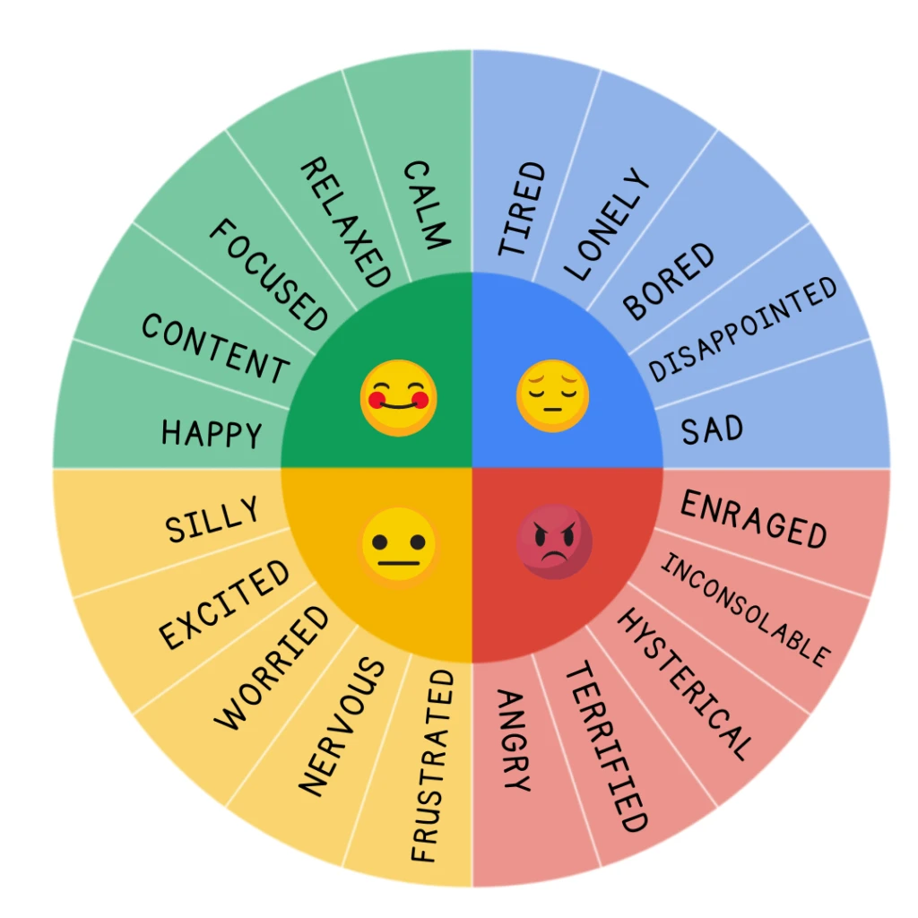
How are you feeling today?
Let us know how you’re feeling about being a mentor today.

Slide 3

Agenda
Why be a mentor, and what are my mentoring skills?
Common mentor conversations
Mentor identity: What do I have to offer an apprentice, and what is my mentoring style?
How can I improve as a mentor?

Slide 4
Why do I want to be a mentor?
Motivation | Yes | No
I have specific knowledge I want to pass on to an apprentice.
Helping others is personally rewarding to me.
I enjoy learning alongside others.
Working with an apprentice is energizing.
I look for new opportunities to further my own growth and development.
I have an interest in seeing my apprentice succeed.
I look for opportunities to inform the future of my profession.
I want to pay it forward.
Adapted from Zachary, L. J. (2012). The Mentor’s Guide. Jossey Bass.
Notes:
As we get going, it may be helpful to remind ourselves why we are mentors and why we are doing the hard work of mentoring teacher apprentices.
It may be an organizational imperative or a voluntary engagement, or both. But if you dig a little deeper, you may find other reasons you didn't suspect. Discovering your core motivation is a little like peeling back the layers of an onion and finding even more layers underneath.
Answer Yes or No as it applies to you:
Are you looking for purpose in your life?
Do you what to contribute to the success of others?
Do you want to share your knowledge, insight and experiences with others?
Do you want to witness the growth and development of others you have had the privilege to guide?
Discuss Mentoring Motivation Checklist.

Slide 5

Check for understanding
Please share one of your motivations for being a mentor.
Notes:
As we get going, it may be helpful to remind ourselves why we are mentors and why we are doing the hard work of mentoring teacher apprentices.
It may be an organizational imperative or a voluntary engagement, or both. But if you dig a little deeper, you may find other reasons you didn't suspect. Discovering your core motivation is a little like peeling back the layers of an onion and finding even more layers underneath.
Answer Yes or No as it applies to you:
Are you looking for purpose in your life?
Do you what to contribute to the success of others?
Do you want to share your knowledge, insight and experiences with others?
Do you want to witness the growth and development of others you have had the privilege to guide?
Discuss Mentoring Motivation Checklist.

Slide 6

Why is mentoring an apprentice important?
Self-improvement
Desire to benefit others
Intrinsic satisfaction
Shape the future of the field by sharing knowledge and experiences to be passed along to others (Zachary, 2012, p. 11)
Notes:
Review before we move into new content. Again, we discussed this previously but want to circle back around to it here as a warm up to reflect on ourselves as mentors. Individuals have different reasons for wanting to be a mentor. Some mentors may want to be a mentor for self-improvement. Giving back to the apprentice may help the mentor feel good about what he/she is offering to the profession. Mentors receive internal feelings of satisfaction. Mentors gain a sense of purpose by sharing their knowledge with others.
Examples:
Mentors gain self-improvement by attending professional development trainings with their apprentice.
Mentors share lessons and designs for centers with their apprentice.
The mentor can conduct research with their apprentice, focusing on an action plan, or goal.

Slide 7
What are my Mentoring skills?
Brokering relationships
Building and maintaining relationships
Building trust
Coaching
Communicating
Encouraging
Exercising curiosity
Facilitating
Goal setting
Guiding
Listening
Managing conflict
Problem solving
Providing feedback
Reflecting
Valuing difference
Notes:
Review before we move into new content. The more comfortable we are with a skill, the more likely we will use it. Some skills, which are discussed in the sections that follow, are more powerful than others in facilitating mentoring relationships. How well you use these skills will relate in whole or in part to your emotional intelligence. If you are self‐aware and socially aware and can effectively manage yourself and your relationships, you will be more likely to feel confident and comfortable with these skills. If you are not comfortable, consider this an opportunity to contribute to your own growth and development by finding assistance in this area. It is not necessary to have all of these skills, but the more mentors have, the more likely the mentoring will be successful for both, the mentor and the apprentice.
Brokering Relationships
Brokering relationships involves accessing your own networks to connect your apprentice to the people and the resources that will be of assistance in achieving their learning objectives. Mentors need to be experienced networkers and have a stable of diverse contacts from whom to draw expertise, resources, and information in order to be successful.
Building and Maintaining Relationships
Too frequently we put great energy into starting a relationship and assume that this momentum will continue to drive the relationship. In fact, relationships that continue over time require ongoing tending, patience, and persistence. One of the testimonies to a successful mentoring relationship is the extent to which mentoring partners feel known by the other. Some people are better at building than maintaining. Mentors need to be adept at both. We will be exploring this recurring idea from many angles as we read on. Remember, however, that a mentoring relationship does not have to result in friendship. Friendship indicates individuals are on equal levels, but in the mentor/apprentice relationship, the mentor is the guide for the apprentice. The line refers to the mentor providing guidance and support and the apprentice being responsible for their learning and development.
Coaching
Coaching and mentoring are kindred spirits. Although the terms are sometimes used interchangeably, they are not the same thing. Coaching focuses on enhancing performance by helping an individual close their knowledge and skill gaps. Mentoring focuses on facilitating the future growth and development of the apprentice. Mentors often need to use coaching skills to help a mentee in determining knowledge or skills gaps that are holding them back and assist in closing these gaps so that they can reach identified learning goals. An example of is this when an apprentice is having difficulty with guidance skills. A coach works specifically on skills and techniques to develop better guidance skills, such as fewer large group activities, classroom arrangement that can help with the prevention of inappropriate behaviors, or language that the apprentice uses that indicates that the child has a choice instead of being given a directive (Let's clean up now, okay? Indicates choice rather than a direction.)
Communicating
Effective communication—being authentic, listening effectively, checking for understanding, and articulating clearly and unambiguously—is an important part of any relationship. Facilitating a learning relationship requires ongoing communication. Effective communication also involves silences: understanding nonverbal cues and being able to pick up on what is behind the words another person is saying.
Encouraging
Mentors who are good at encouraging come in many guises: cheerleaders, confidence builders, gentle persuaders, inspirers, and motivators. Encouragement keeps the apprentice focused on the future by first holding out an optimistic vision of what is possible and then keeping up the momentum up while working toward achieving learning goals. Positive reinforcement and validation is important; the right word said at the right time can make all the difference.
Exercising Curiosity
When mentors demonstrate curiosity, showing a genuine desire to learn from, with, and about their apprentice, they will develop more trusting and collaborative relationships. What's more, they will be more likely to generate innovate ideas and spur positive change.2 Demonstrate curiosity by being inquisitive, letting apprentice explore possibilities, and deeply listening to your apprentice.
Facilitating
Artful facilitation is the key to promoting shared learning, reflective practice, and deeper insight for an apprentice. This is the means by which mentors support and challenge their apprentice to learn, grow, and develop. This includes the monthly progress form that you review with your apprentice. Mentors must be aware of learning styles and use that knowledge as a basis for enlarging the apprentice's thinking and perspective. Respect for different perspectives is important to creating a shared learning experience and demands that mentors be flexible and open to learning. When you engage your apprentices as active participants in their own learning, you encourage self‐reflection and ownership.
Providing feedback
Apprentices rely on mentors as trusted sources of candid and direct feedback. Try to create an expectation for ongoing constructive (not corrective) feedback during your monthly progress check meetings. Remember that most people are better at giving feedback than they are at asking for it, receiving it, and accepting it. Have your apprentice tell you what they just heard from your feedback. This is an opportunity to clarify any misunderstandings that may develop. As a mentor, you need to model good feedback practices and ask for feedback on your own feedback and be prepared to accept constructive criticism as well. Feedback creates momentum by keeping apprentices on track and moving in the right direction.
We can use the monthly competency tracker and our apprentice’s self reflection form to help guide our feedback, self-reflect, decide how to communicate feedback, and provide a follow up timeline with concrete steps to help our apprentices master the competencies.
Note: We will share the monthly competency tracker on Zoom and we will explain the monthly tracker with details from the instruction sheet.
Evidence Collection: Mentors will document evidence of apprentice competency mastery throughout the month. This evidence can include, but is not limited to:
Direct Observation: Witnessing the apprentice successfully perform a task or skill.
Work Samples: Reviewing completed assignments, projects, or work products.
Self-Assessment: Reviewing the apprentice's self-reflection on their progress and areas for additional support.
Feedback: Collecting feedback from the apprentice on their learning experience and challenges
Documentation: Mentors will record their observations on the Apprentice Monthly Progress Tracking form. This will be accessible to both the mentor and apprentice.
Feedback: Mentors will provide constructive feedback to the apprentice, highlighting strengths and areas that need support.
Submission: Upon completion of form, upload to the apprentice’s secure ECE RTAP folder.
Finally, we will walk through an example where an apprentice indicated on their self-reflection form that they need more support with competency 1.1 and the mentor noted the same in their tracker. For example, we will say that this apprentice does the following well:
uses multiple modalities to communicate to children in the class including, but not limited to, signs, pictures, gestures, Augmentative Alternative Communication (AAC) device
Can identify various children's learning style and preference
But needs to work on:
Responds to at least 80% of children's attempts at engagement or communication Gives children at least five positive statements for every one direction or negative statement
We will walk the audience through how useful the monthly tracker and self-reflection forms are to giving feedback that can help apprentices achieve a clear and concrete mutual understanding of the path forward.
Goal Setting
Well‐defined goals drive the learning process of a mentoring relationship, but setting those goals requires time and good conversation between mentor and apprentice. As a mentor, your role is to help your apprentice clarify, crystallize, and set realistic goals. This means engaging your mentoring partner in a collaborative, robust goal‐setting process that culminates in a game plan for how to achieve those goals. As you review the competencies with your apprentice identify one or two that the apprentice needs to focus on for a set period of time. This could be two weeks or until your next monthly check in. Have the apprentice set benchmarks for steps they will meet along the way. For example, "Takes advantage of available opportunities for professional development and continuous learning" could be broken down into 3 steps: 1) Locating local, state or online opportunities for professional development; 2) Selects and registers for one professional development. Event; and 3) Attends the professional development event.
Guiding
Mentors act as guides on the learning journey, leading mentees as they create and grow into their desired future. The mentor guides by being a role model and leads by example. This means that mentors must be familiar with the program so that they can adequately prepare the apprentice for what lies ahead and help them stay focused on their destination. A good guide can interpret the language, help apprentice make meaning of the experience, and arrive safely. Your apprentice is at the beginning stage of employment in early childhood education. Be sure that your apprentice knows how the coursework and tasks they are currently completing can lead into a CDA or Associate's degree which can then lead to a Bachelor's degree and perhaps even a Master's degree. Also be sure that your apprentice understands that many pathways exist to different types of employment in ECE. This includes positions such as home visitor, advocate, or even employment at the state or national level in roles that support the field.
Listening
Being a good listener is the attribute that mentees value most in a mentor. Effective listeners balance talking and listening, and they grasp the content and context of what is being said. Good listeners listen for the noise and for the silence, and they use what they hear as teachable moments to encourage reflective thinking. Effective listening makes the apprentice feel heard and sends the message that you genuinely care. Thus, when conducting the monthly
Managing Conflict
Conflict can occur in any relationship. Managing it effectively requires direct and honest conversation about differing points of view. It does not mean eliminating differences. Rather, it is about inviting dialogue to understand varying points of view.
Problem Solving
It is not your job as mentor to solve your mentees’ problems. Rather, you should provide assistance in the problem‐solving process by engaging mentees in finding solutions to the problem. By asking questions and holding up a mirror, you can help them define problems. Together, you can discuss problem‐solving strategies and alternative scenarios for working the problem through to a viable solution.
Reflecting
If you personally engage in self‐reflection, you are more likely to be adept at using reflection to facilitate learning in a mentoring relationship. By reflecting, mentors raise apprentice levels of awareness about how they frame their thoughts, the way they make meaning, and the way they translate ideas into action. Being comfortable with the process skill of reflection enables you to consistently model that skill for the apprentice. The apprentice should be encouraged to self-reflect daily on what worked well and what did not, what skills they gained, questions they may have and their successes for the day.
Trust Building
Trust creates a relationship in which both you and your apprentice are willing to share openly. With trust, your apprentice is able to accept your feedback without defensiveness. Remember, trust is not a given. You must take the time to build trust—in yourself, and between yourself and your apprentice—from the very beginning of your partnership. Trust is developed when the mentor and apprentice show respect for one another, when they are honest and accountable, when they are empathetic and considerate towards each other. Trust is developed through actions and consistent effort building a positive and caring relationship.
Valuing Difference
One of the benefits of mentoring for both mentor and mentee is the exposure to different perspectives. During the course of a mentoring relationship, mentors are likely to hear views that are different from their own. These may be positional differences, generational differences, learning style differences, or gender or ethnic differences. Each individual has their own story: Mentors need to be able to understand, learn from, and value differences.

Slide 8
Check for understanding
Share one skill you feel comfortable with and one skill you feel you need growth.
Brokering relationships
Building and maintaining relationships
Building trust
Coaching
Communicating
Encouraging
Exercising curiosity
Facilitating
Goal setting
Guiding
Listening
Managing conflict
Problem solving
Providing feedback
Reflecting
Valuing difference

Slide 9
Common mentor Conversations
Agenda | Strategies | Questions
Take time to build trust and get to know each other. | Consider sending an introductory email before your first meeting. | What do you want to learn about each other?
Share guiding principles. | Share any truisms or wisdom with your apprentice. | What is the best advice that you have ever been given?
Share career highlights and milestones. | Exchange bios in advance of the conversation. | Which of your apprentice’s experiences are you curious about?
Share mentoring stories. | Discuss previous mentoring experiences with your apprentice. | What did you each learn from your experiences?
Adapted from Zachary, L. J. (2012). The Mentor’s Guide. Jossey Bass.
Notes:
Start of new content.
Many mentors coach the way they were coached. Coaching and mentoring are kindred spirits. Although the terms are sometimes used interchangeably, they are not the same thing. Coaching focuses on enhancing performance by helping an individual close their knowledge and skill gaps. Mentoring focuses on facilitating the future growth and development of the mentee. Mentors often need to use coaching skills to help a mentee in determining knowledge or skills gaps that are holding them back and assist in closing these gaps so that they can reach identified learning goals.
Some coaching skills include inclusive leadership, effective communication, and goal-oriented.
Effective mentors learn new ways of coaching and mentoring practices.
Many mentors explore responsive approaches and embrace “becoming” a mentor.
Discuss table above.

Slide 10
Common mentor Conversations
Agenda | Strategies | Questions
Share mentoring assumptions. | Talk about assumptions and limitations that you each bring to the relationship. | What assumptions do you hold about your relationship?
Determine your mutual relationship needs and expectations. | Discuss your wants, needs, and expectations for the relationship. | What do you need from your apprentice and vice versa at the beginning of the relationship?
Talk about the apprentice’s learning and development goals. | Have a conversation about your apprentice’s goals and outcomes. | What does your apprentice aspire to do, to create, to fulfill?
Discuss personality and learning styles. | Talk about your individual learning styles. | How will you communicate with each other in a way that honors your differences?
Adapted from Zachary, L. J. (2012). The Mentor’s Guide. Jossey Bass.
Notes:
Start of new content.
Many mentors coach the way they were coached. Coaching and mentoring are kindred spirits. Although the terms are sometimes used interchangeably, they are not the same thing. Coaching focuses on enhancing performance by helping an individual close their knowledge and skill gaps. Mentoring focuses on facilitating the future growth and development of the mentee. Mentors often need to use coaching skills to help a mentee in determining knowledge or skills gaps that are holding them back and assist in closing these gaps so that they can reach identified learning goals.
Effective mentors learn new ways of coaching and mentoring practices.
Many mentors explore responsive approaches and embrace “becoming” a mentor.
Discuss table above.

Slide 11
Check for understanding
1. Pick an agenda item that you have not engaged in with your apprentice.
2. Describe a strategy that you could use to communicate the chosen item with your apprentice.
Agenda
Take time to build trust and get to know each other.
Share guiding principles.
Share career highlights and milestones.
Share mentoring stories.
Share mentoring assumptions.
Determine your mutual relationship needs and expectations.
Talk about the apprentice’s learning and development goals.
Discuss personality and learning styles.
Adapted from Zachary, L. J. (2012). The Mentor’s Guide. Jossey Bass.
Notes:
The apprentice should set learning goals before entering the classroom. During each monthly meeting, goals should be revisited and revised.
Before the apprentice begins in the classroom, the mentor should reach out, introduce themselves, and make a point to get to know the apprentice.
Before each monthly meeting, the mentor needs to review the apprentice’s self-reflection form to better understand where the apprentice is coming from. For example, if an apprentice feels they need more support to master a competency, but you, as the mentor, feel you’ve spent a lot of time in that area with your apprentice, then this can give you insight into how to progress forward. You might realize that the many supports you provided are not working for your apprentice. This can lead to a very productive and fruitful conversation with your apprentice.
Another scenario could be if your apprentice reports that they have or have not mastered a competency that you feel otherwise. A conversation to normalize expectations is needed in this case.
For example, if your apprentice reports that they are still struggling with competency 1.3: Creates anecdotal notes to guide development of activities for children, but you have observed your apprentice doing this time and time again in an effective way, you could praise your apprentice for achieving this competency. After providing the evidence of mastery to your apprentice, you could provide other examples of how your apprentice could create anecdotal notes to guide development. This will awaken your apprentice to the fact that there are many correct ways to do things and trying out new strategies is how we continue developing.
On the other hand, if your apprentice reports that they have mastered competency 1.3, but your evidence suggests otherwise, you might give your apprentice time to provide you with the evidence of their mastery. You can use what your apprentice provides to re-normalize expectations and highlight any false assumptions that your apprentice made. To ensure that you are maintaining a positive relationship, you could provide stories of how you struggled with a competency, provide additional concrete strategies that you would like your apprentice to try before marking this competency as mastered, and tie mastery into your apprentice’s personal goals. Many times, you will find yourself finding some middle ground between the evidence that your apprentice provides and the evidence that you collected.

Slide 12

What is my Mentor Identity?
Identity is defined as an enduring set of attributes, beliefs, values, motives and experiences by which people define themselves (Daloz, 2012).
Mentor identity is a process of being and becoming, shaped by interactions between self-image and perceptions of how others view oneself.
Notes:
Mentor identity is how we view ourselves as mentors. We need to look in the mirror and ask ourselves about our attributes, beliefs, values, motives and experiences that define who we are as a mentor. Our mentor identity is defined by internal and external perspectives, the way we see ourselves, and the way others view us as mentors.
Mentoring becomes a top of the mind awareness. As mentors think about their role and the impact they will have in the lives of their apprentice, they often realize the integral aspect of the mentoring practice and the importance of being an effective mentor.

Slide 13
Check for understanding
Our identity evidences our authenticity and demonstrates the values, beliefs and perspectives we espouse as we perform our roles as mentors, making who we are an integral aspect of mentoring practice.
Who do you believe you are as a mentor?
How is your mentor identity shaped by your experiences, values, beliefs, and perspectives?

Slide 14

What is my Mentoring Style?
Mentoring style refers to the forms of behavior or strategies that mentors employ.
Mentors are guides (Daloz, 2012).
“Effective mentors need a style that balances the level of engagement in the relationship, being approachable and available, yet providing the apprentice with freedom to explore their learning and learn from their experiences” (Daloz, 2012, p. 15)
Notes:
Mentoring style refers to the forms of behavior or strategies that mentors employ. Essentially, mentors are guides (Daloz, 2012). Effective mentors need a style that balances the level of engagement in the relationship, being approachable and available, yet providing the apprentice with adequate autonomy to explore their learning and learn from their experiences. This balancing act focusses on the learning and development of the apprentice and provides a safety net for the apprentice’s learning experiences.
How do you know your mentoring style? You will need to reflect on past mentoring experiences, ask for feedback from your apprentice, identify your strengths and weaknesses and think about how you approach others.
What are mentoring styles? Some styles include advising, coaching, connecting, sponsoring, cheerleading, and challenging. You might be a combination of all of these styles.
How do you build one? You need to have clear expectations, consider ideas from others, set goals, and use your experiences to help develop your mentoring style.
Here are some examples of mentoring styles derived from Jim Knight (2009):
Authoritative- telling/direct, very little listening, asserting power over your apprentice
Directive – Similar to authoritative, but you do not assert power over your apprentice. You do most of the thinking and talking, but you guide your apprentice along the way and ask for their feedback.
Facilitative - converse about ways to improve. The mentor listens intently, but there is two-way communication. The apprentice owns part of the conversation.
Reactive - waiting for apprentice to initiate a conversation. This can emerge as the mentor/apprentice relationship deepens and becomes open to conversation.
Proactive – mentor seeks out conversations with their apprentice. This tends to be used in the beginning stages of the relationship as the apprentice is learning what is important and what needs to be mastered.
Bringing it all together:
While figuring out your own mentoring style requires introspection and asking for co-workers or those that you trust to provide feedback, we will walk through a few examples of mentoring styles adapted from Jim Knight (2009):
For example, you might be more of a facilitative coach, which challenges your apprentice to own part of the conversation. In this case, you act as a sounding board for your apprentice. You allow your apprentice to speak freely and honestly without judgement. You actively listen with empathy and without interruption. Then, you follow up with questions that challenge your apprentice’s thinking and lead them to a new conclusion. This mentoring style assumes that your knowledge and expertise as a mentor has already been communicated and your role is now to unpack your apprentice’s mental models of the competencies. This type of mentoring style works well when your apprentice is mastering competencies and has earned your trust as a colleague.
On the other hand, you may play a more directive role where you do most of the thinking and you help establish strategies, goals, and next steps with your apprentice. This type of mentoring style tends to work well when your apprentice needs extra support or you are at the beginning of developing a relationship with your apprentice. This style makes the assumption that your apprentice does not know how to use the tools and strategies to inform their practice. Note that this is different from authoritative in that there is still two-way communication and you, as the mentor, are not asserting power over your apprentice.

Slide 15
Check for understanding
Reread this quote:
“Effective mentors need a style that balances the level of engagement in the relationship, being approachable and available, yet providing the apprentice with freedom to explore their learning and learn from their experiences” (Daloz, 2012, p. 15)
How does your mentoring style balance engagement, approachability, availability, and providing the apprentice with freedom to learn from their experiences?

Slide 16
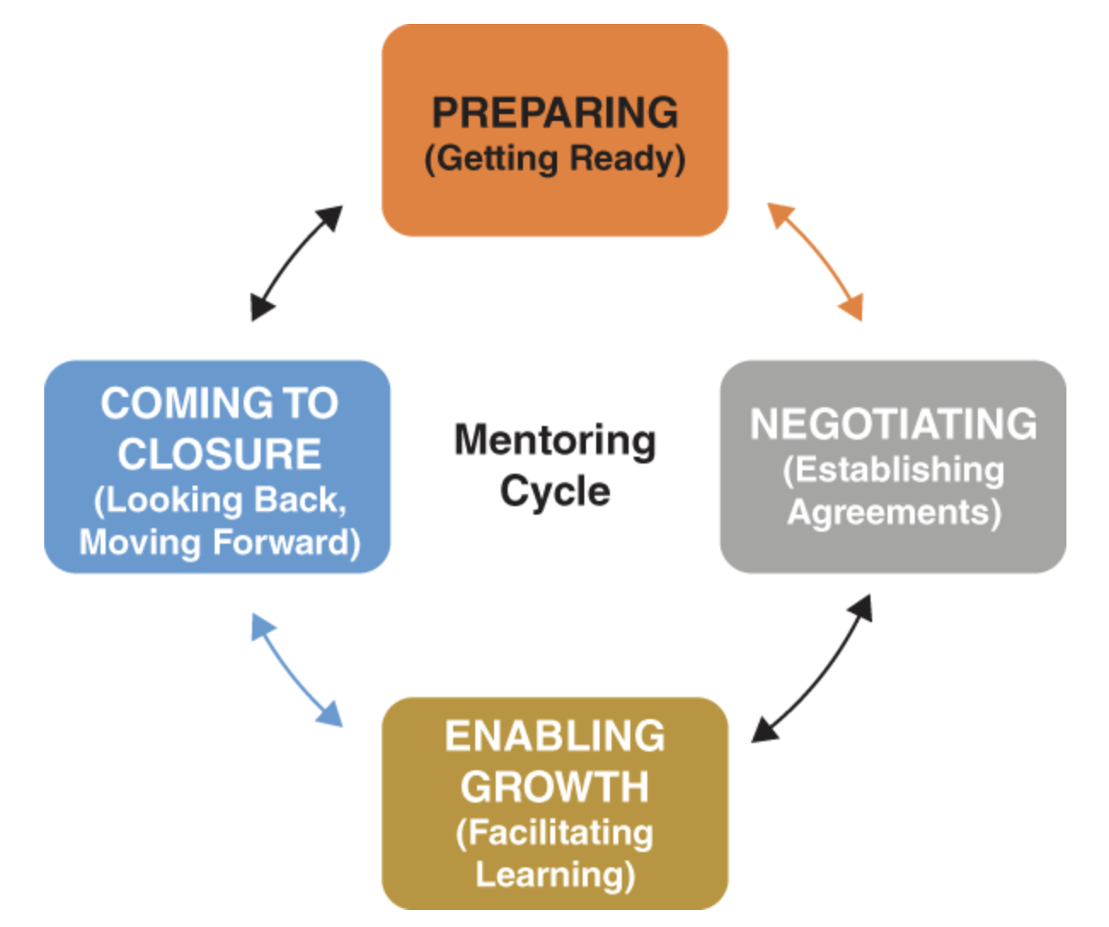
What do I have to offer an apprentice?
I can provide support, feedback, and direction.
I can create and maintain a welcoming environment and provide emotional and psychological support.
I can make resources available.
I can be empathetic, caring and nurturing.
Notes:
A quality mentor can provide direction and support in various ways. It is important that a quality mentor show empathy and equip apprentice’s with teaching knowledge and skills. A quality mentor will be cognizant of the challenges and emotional ups and downs that an apprentice is likely to experience. It is important for a mentor to create and maintain a welcoming environment and provide ongoing support.

Slide 17
What is expected of the mentor and apprentice?
Expectations to Set
The mentor needs to be available.
The mentor needs to provide constructive feedback.
The mentor needs to be accountable.
The mentor needs to be trustworthy.
The apprentice needs to follow through on agreements.
The apprentice needs to be proactive and accountable.
The apprentice needs to be open to receiving feedback.
Adapted from Zachary, L. J. (2012). The Mentor’s Guide. Jossey Bass.
Notes:
Job Function 6 states that the apprentice engages in reflective practice and continuous learning. An effective mentor would provide opportunities for professional development and continuous learning.
During the monthly meetings the apprentice should receive feedback from the mentor and improve practice under their guidance.
The mentor models compassionate behavior for the apprentice.
Expectations and assumptions about the mentor's role need to be clear to both partners from the outset. Role refers to the anticipated or expected functions a mentor might play—team builder, coach, confidant, teacher, guide, advocate, and so on. You and your apprentice may have different ideas about this. Complicating matters, different roles may be required at different points in the relationship, blurring the mentor's role. Because of this lack of clarity, it is crucial to keep revisiting both partners’ understanding of their roles.
One way to work on these aspects of mentoring is through goal setting. Mentoring is a development opportunity for mentors too. No matter how many times you have been a mentor, you can always get better at it. Stretch goals focus on the future—getting you out of your comfort zone and stretching you to grow into the best mentor you can be. These bold goals of possibility can help you bridge the distance between good and better. They can elevate your leadership, increase your personal satisfaction in the role, and achieve better outcomes for yourself and your apprentice.
Discuss stretch goal example chart.
Mentors need to assess the apprentice’s performance. On a form, a sticky note, or face to face, mentors need to share suggestions, positive comments, and/or ways to improve, daily
This can be challenging to do daily because your apprentice may need time to reorient themselves to improve. However, mentors can help facilitate the development of new mental models of teaching by providing scaffolding that can be completed daily. For example, after having a conversation about improving in a certain competency, the apprentice will need to think through, envision, and even list the strategies that they will incorporate into their practice. This is something that can be done on an evening or weekend. Mentors could task apprentices with listing, drawing, or even recording a new strategy as practice before they get into the classroom again. As the apprentice is practicing, they should record their practices in the growth opportunities and success sections of their monthly reflection forms.

Slide 18
What is expected of the mentor and apprentice?
Objectives | Activities | Resources | Timeframe | Next Step
Find out which books I should read. | Talk with role models. | Various colleagues | Next month | Who do I ask?
List all books. | Read the top three. | Funding to purchase books | Next month | Order books.
Identify common approaches. | Read the books. | Books and learning log. | February – April | Keep at it regularly.
List techniques to master | Review co-workers’ lists |  | By April 30 | Compare and contrast lists
Pick one technique and practice it. | Keep notes on what I am doing. | Learning log | May | Practice
Gather feedback. | Ask colleagues for specific feedback | Time with colleagues | May – June | Talk with mentor
Work at getting better. | Continue to seek feedback. | Specific questions | Ongoing | Review learning log.
Adapted from Zachary, L. J. (2012). The Mentor’s Guide. Jossey Bass.
Notes:
Expectations and assumptions about the mentor's role need to be clear to both partners from the outset. Role refers to the anticipated or expected functions a mentor might play—team builder, coach, confidant, teacher, guide, advocate, and so on. You and your mentee may have different ideas about this. Complicating matters, different roles may be required at different points in the relationship, blurring the mentor's role. Because of this lack of clarity, it is crucial to keep revisiting both partners’ understanding of their roles.
One way to work on these aspects of mentoring is through goal setting. Mentoring is a development opportunity for mentors too. No matter how many times you have been a mentor, you can always get better at it. Stretch goals focus on the future—getting you out of your comfort zone and stretching you to grow into the best mentor you can be. These bold goals of possibility can help you bridge the distance between good and better. They can elevate your leadership, increase your personal satisfaction in the role, and achieve better outcomes for yourself and your apprentice.
Discuss stretch goal example chart.
The stretch goal is to “Learn to be more comfortable and competent at conflict management”
Measures of Success are ”Getting positive feedback from colleagues. Feeling less anxious in situations that call for managing conflict. Using the skill regularly so that it comes naturally to me."

Slide 19
Where can I improve as a mentor?
Review the following list and check all items that apply to you with respect to your prospective mentoring relationship. (Zachary, 2012):
I have a sincere interest in helping this person succeed.
There appears to be mutual interest and compatibility.
My assumptions about the process are aligned with those of my apprentice.
I am clear about my role.
I am the right person to help this apprentice achieve their goals.
I can enthusiastically engage in helping this person.
Notes:
The preparation you do on your own in advance impacts your readiness to mentor and the quality of the mentoring relationship. Preparation of the relationship begins in earnest when the mentoring partners get to know one another and explore issues together. Getting to know a mentee does not mean knowing everything about that person. Rather, gaining a good sense about who the person is and what they bring to the relationship will help you make a strong connection and facilitate a more meaningful learning experience. Once the relationship preparation steps are complete, it is time to establish the agreements that build the foundation to support, guide, and nurture the relationship.
Are you ready to make a difference?
Are you ready to leave a beneficial contribution?
Are you ready to gain a sense of satisfaction from mentoring an apprentice?
Are you ready to put in the required energy, time, and passion into practice?
Discuss readiness checklist chart.

Slide 20
Where can I improve as a mentor?
Review the following list and check all items that apply to you with respect to your prospective mentoring relationship. (Zachary, 2012):
I am willing to use my network of contacts to help my apprentice succeed.
I can commit adequate time to mentoring my apprentice.
I have access to the kind of opportunities that can support my apprentice’s learning.
I have the support that I need to be able to engage in this relationship in a meaningful way.
I am committed to expanding my own mentoring skills.
I have a mentoring development plan in place for myself.
Notes:
The preparation you do on your own in advance impacts your readiness to mentor and the quality of the mentoring relationship. Preparation of the relationship begins in earnest when the mentoring partners get to know one another and explore issues together. Getting to know a mentee does not mean knowing everything about that person. Rather, gaining a good sense about who the person is and what they bring to the relationship will help you make a strong connection and facilitate a more meaningful learning experience. Once the relationship preparation steps are complete, it is time to establish the agreements that build the foundation to support, guide, and nurture the relationship.
Are you ready to make a difference?
Are you ready to leave a beneficial contribution?
Are you ready to gain a sense of satisfaction from mentoring an apprentice?
Are you ready to put in the required energy, time, and passion into practice?
Discuss readiness checklist chart.

Slide 21
Check for understanding
Based on your list, pick one area that is authentic to you and one area to improve upon.
Please share which items from the list you picked.
Example:
Authentic: I have a sincere interest in helping this person succeed.
Improve: There appears to be mutual interest and compatibility.
In the next Community of Practice, we will discuss having conversations about improvement with our apprentices based on the competencies.
Notes:
The preparation you do on your own in advance impacts your readiness to mentor and the quality of the mentoring relationship. Preparation of the relationship begins in earnest when the mentoring partners get to know one another and explore issues together. Getting to know a mentee does not mean knowing everything about that person. Rather, gaining a good sense about who the person is and what they bring to the relationship will help you make a strong connection and facilitate a more meaningful learning experience. Once the relationship preparation steps are complete, it is time to establish the agreements that build the foundation to support, guide, and nurture the relationship.
Are you ready to make a difference?
Are you ready to leave a beneficial contribution?
Are you ready to gain a sense of satisfaction from mentoring an apprentice?
Are you ready to put in the required energy, time, and passion into practice?
Discuss readiness checklist chart.

Slide 22

Wrap-up
Next session:_______________
Location/Link:________________
Questions?

Slide 23
Resource Page
Daloz, L. A. (2012). Mentor: Guiding the journey of adult learners. Wiley ; John Wiley distributor.
Ellis, N. J., Alonzo, D., & Nguyen, H. T. (2020). Elements of a quality pre-service teacher mentor: A literature review. Teaching and Teacher Education, 92, 103072. https://doi.org/10.1016/j.tate.2020.103072
Fueling workforce growth through AI-powered mentoring. Mentoring Complete. (2024, June 4). https://www.mentoringcomplete.com/
Lammert, C., DeWalt, L. M., & Wetzel, M. M. (2020). “becoming” a mentor between reflective and evaluative discourses: A case study of identity development. Teaching and Teacher Education, 96, 103179. https://doi.org/10.1016/j.tate.2020.103179
Zachary, L. J. (2012). The Mentor’s Guide. Jossey Bass.

Slide 24


Name, title, contact info

