Slide 1

Community of Practice for Mentor Teachers
Session 5: Negotiating the Relationship
Notes:
Welcome to session # 5 of our Community of Practice! Today our focus is on negotiation the relationship between mentor and apprentice.

Slide 2

Agenda
Preparing for conversations
Addressing competencies at the monthly/quarterly meetings
Session wrap-up
Notes:
Our agenda for today is to talk about preparing for monthly meeting conversations; addressing competencies at the monthly/quarterly meetings; and our session wrap up.

Slide 3

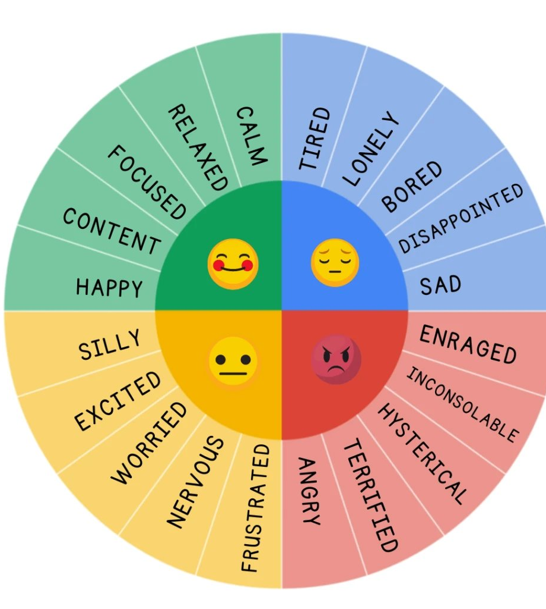
How are you feeling today?
Let us know how you are feeling about your apprentices' skills.
Notes:
Each month we've been asking how you feel. Today we'd like for you to identify in the chat how you are feeling about your apprentices' skills up at this point. You may provide a sentence of explanation if you so desire.

Slide 4

Communication is KEY!
Positive communication can be easy.
Difficult conversations may not be so easy.
Notes:
This slide introduces the theme of this CoP. Communication is a crucial aspect of almost all relationships. Most of us enjoy time spent with others in positive communication, but we may avoid difficult conversations. However, that doesn't need to be the case.

Slide 5


Positive Communication
Notes:
Feedback is essential for growth. When we have positive things to report to our apprentices, we reinforce the good things that they are doing. Through positive feedback, we encourage apprentices to continue engaging in effective instructional practices. However, positive feedback can also be used to push our apprentices to take the next step in their journey. Maybe the next step is gaining more responsibility, making a strategy more authentic, or trying out new strategies on their own.

Slide 6

Using Competencies to give positive feedback
Competency 1.7 is a competency that the apprentice should master quickly, as safety is a major concern in early childhood environments.
To build from here, the mentor can encourage the apprentice to become familiar with the Indiana health and safety guidelines and devise ways to help the apprentice master this competency.
Notes:
In this webinar, we organically added in T-RAP tools. In this slide, we will direct participants to the competency tracker and explain competency 1.7 which is one where we can hopefully provide positive feedback early in the apprentice's time in the classroom.

Slide 7

Preparing to give feedback at meetings
Steps for Successful Preparation
Set the tone and purpose for the conversation.
Get to the point and name it professionally.
Give specific examples. This might involve modeling effective instructional practices and have your apprentice practice with instant feedback.
Describe the effect of the current mastery level on the school, colleagues, or children.
Share your willingness to resolve the issue and have and dialogue and discussion.
Notes:
Preparing for meetings will make the time with the apprentice more productive. The steps identified on this slide remind us of steps we need to consider prior to meetings. As a result of preparation you will be ready to:
Set the tone and purpose for the conversations. Connection before correction – sincerity and willingness to be authentic precedes the rest.
Get to the point and name concerns professionally. Name the issue with a professional behavior, preferably one indicated in the competencies.
Give your apprentice a specific example of a competency for improvement. Use only one or two current ones. Make them vivid and watch for trigger words (words that will make the listener shut down). If applicable, you can use modeling to show your apprentice exactly what the effective instructional practice looks and sounds like. Having your apprentice practice in front of you will allow you to give them instant feedback.
Describe the effect of the current mastery level on the school, colleagues or children. Describe the consequences of not mastering this competency on others. Don't dramatize; describe the impact.
Share your willingness to resolve the competency with the apprentice and have dialogue and discussion. Stay open with your comments and your body language. Be able to finish your statement and stay present so the dialogue can begin.

Slide 8
Check for Understanding
Set the tone and purpose of the conversation.
Give specific examples.
Describe the consequences of this behavior on others.
None of the above.
During which step is connection before correction important?
Notes:
Answer is A.
Set the tone and purpose for the conversations. Connection before correction – sincerity and willingness to be authentic precedes the rest.

Slide 9

Language is important when identifying Areas of need!
Effective Wording;
The expectation is …
This is not negotiable …
Please begin to implement …
You are required to …
Please do the following ...
Notes:
As mentors we tend to want to underplay the significance of a competency when an apprentice is struggling with a competency, but what happens is that the apprentice can begin to think that their words or actions don't need much improvement. The phrases that are not effective are listed on the left hand of this slide. In order to get the desired mastery from the apprentice it is important to be clear in your expectations. The phrases on the right-hand side of this slide are much more specific about how the apprentice should begin to demonstrate mastery.
Another phrase that we often use both in working with children and the apprentice is to add the word "okay" at the end of directions. Thus, for competency 3.4 which is about maintaining accurate records, we might find ourselves saying things like, "Please begin to implement accurate recording of which children have eaten snacks and lunch, okay?" Adding okay with a questioning tone of voice implies that the apprentice (or children) have a choice, when our intent is that there is no choice in the matter.

Slide 10
Check for Understanding
Which is an example
of ineffective wording?
Please do the following …
You are required to …
This is not negotiable …
You might consider …
Notes:
In the chat please identify whether A, B, C, or D is an example of ineffective wording.
Answer is D.
In the chat, indicate how you might rephrase item D into more effective wording.

Slide 11
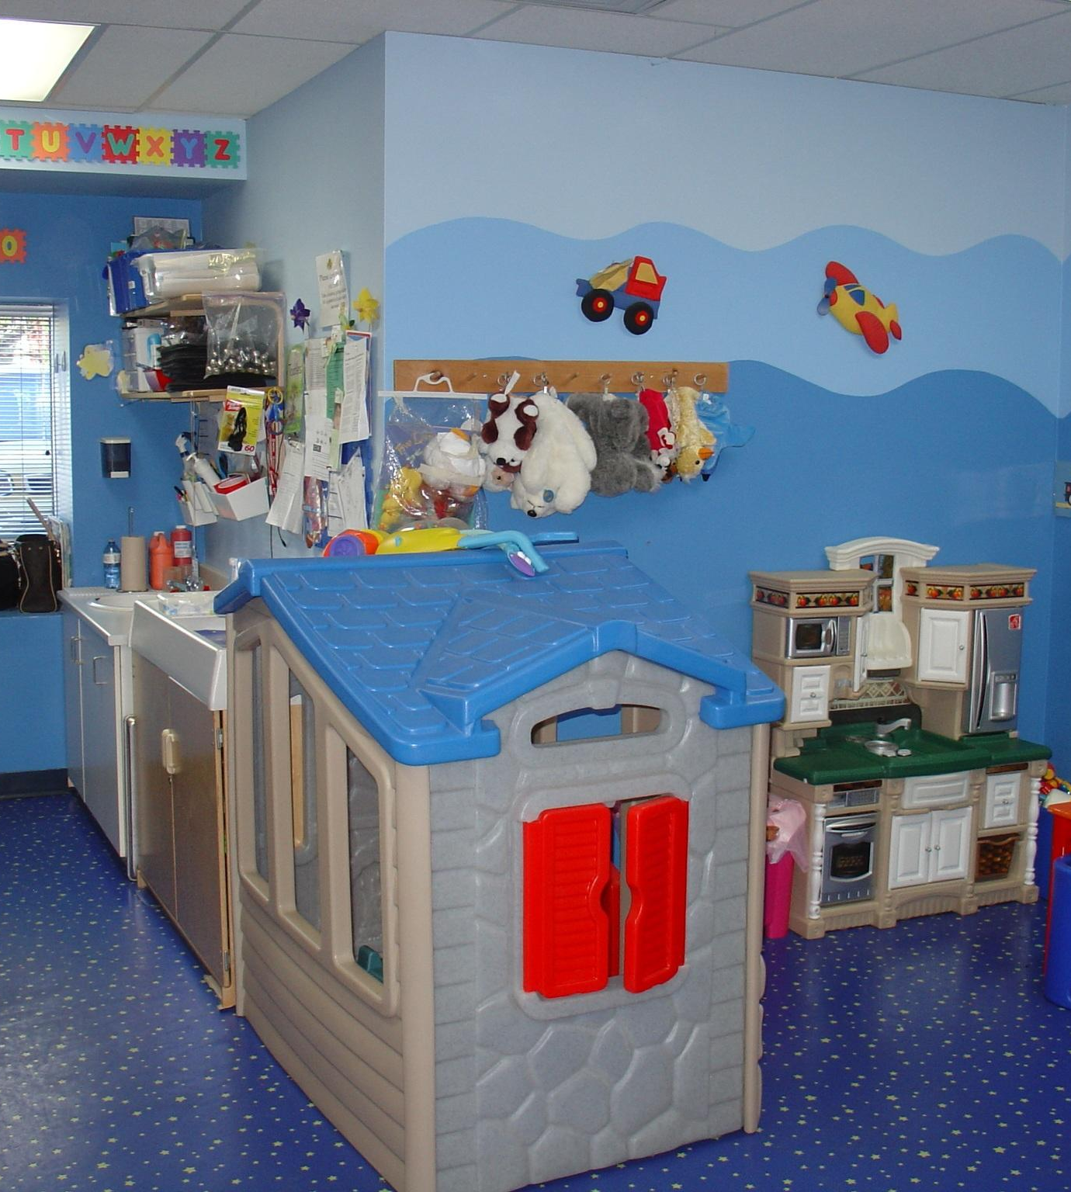
Progress meetings are an opportunity for discussions:
Competency 2.4 not being met:
“Supports purposeful play in the environment with a focus on learning.”
Apprentice understands the importance of play but does not take advantage of learning moments.
Notes:
Here we reference the competency tracker again.
I will read through the slide and then we will role play the following example that describes a teachable moment: The apprentice is in the dramatic play center with two children who are pretending that they are working at a restaurant. One child asks the apprentice, "What do you want to eat?", to which the apprentice replies, "I'll have a slice of pizza." The apprentice has missed the opportunity to work on vocabulary with children where they could have introduced/reviewed restaurant language by responding, "I don't know what you serve. Do you have a menu?" The child can then respond with a real or pretend menu.
Role Play #1:
We will role play this scenario and how a mentor might give feedback to this apprentice to help them improve. We will ask the participants what they observed (strengths and areas of need).

Slide 12

What you can say When a competency is not yet being met…
Competency 5.2 not being met:
“Maintains confidentiality of child information.”
Apprentice is heard talking with friends using the full name of a child in her classroom.
Notes:
Here we reference the competency tracker again, so mentors will get plenty of practice with the competencies.
Children say and do the darndest things, and we love to share those stories with others. On the other hand, we may suspect the child has a developmental issue. Whatever the case or our desire to share the information with others, it is imperative that the apprentice understand the importance of not using the child's name when telling about they day to others or on social media.
Role Play #2:
Here, we will role play this scenario again. We will role-play both the apprentice failing to maintain confidentiality and how a mentor might approach the situation. We will ask participants what they observed (strengths and areas of need).

Slide 13

Check for understanding
Apprentice feels they are doing well on all competencies. You, however, feel that there are several competencies that the apprentice is not yet demonstrating.
What might you say to the apprentice?
Notes:
Here we reference the apprentice self-reflection form and provide a common example.
This is great practice for participants to think through and get feedback on once they share in the chat. Responding to this situation will take careful thought and planning.

Slide 14

When a problem arises:
Identify the problem
Identify the outcome.
What are the desired behaviors?
What knowledge, skills, and dispositions does the apprentice need to meet the desired outcomes?
What strategies can you use to promote the apprentice's growth?
What resources does the apprentice need in order to successfully carry out these strategies?
Notes:
Sometimes we may instruct the apprentice to engage in changing their behavior or words. Unfortunately, they may struggle to be successful in making the change on their own. This slide will be a walkthough of how we can provide assistance to the apprentice through a problem-solving approach.
Clearly frame the issue (problem).
Competency 3.1 is not being met - "Supports the assessment of each child in the classroom by completing anecdotal notes on each child to document progress and opportunities for individualization."
Identify this in terms of what you want and articulate this concretely.
Apprentice needs to write more specific anecdotal notes for all children.
This moves from the broad, imprecise goals to strategically focus on what these will look and sound like.
Apprentice will write anecdotal notes specific to five children over the next week. The notes should identify specific skills the child has and what they might be ready for next.
Identify the internal obstacles that might keep the apprentice from achieving the desired goal.
Apprentice struggles with specificity in notes that don't allow them to plan for individual children's needs.
Focus on ways to help the person implement the change desired.
Strategy 1: Apprentice writes one anecdotal note for a child, and together we review what was written well and where there is still room for improvement.
Focus on what is needed to be able to execute the strategies.
As the mentor, I will provide samples of my anecdotal notes on different children to model what the expectations are for these notes.

Slide 15

Check for Understanding
Share one of the steps that you have not engaged with in the past and provide an example of how you could use it.

Slide 16
Final thoughts:
Use your meetings effectively.
Sometimes assisting the apprentice may mean acknowledging our own weaknesses.
Focus on the positive and your apprentice will improve!
Notes:
This is the summary of this session. I will also share that during our next session we will do a deeper dive into the competencies and how to help the apprentice with developing the skills using the checklists.

Slide 17

Wrap-up
Next session:_______________
Location/Link:________________
Questions?

Slide 18
Resource Page
Abrams, J.B. (2009) Having hard conversations. Corwin.

Slide 19

Name, title, contact info

