Slide 1

Community of Practice for Mentor Teachers
Session 3: Who We Are and What We Bring to the Apprentice Relationship

Slide 2

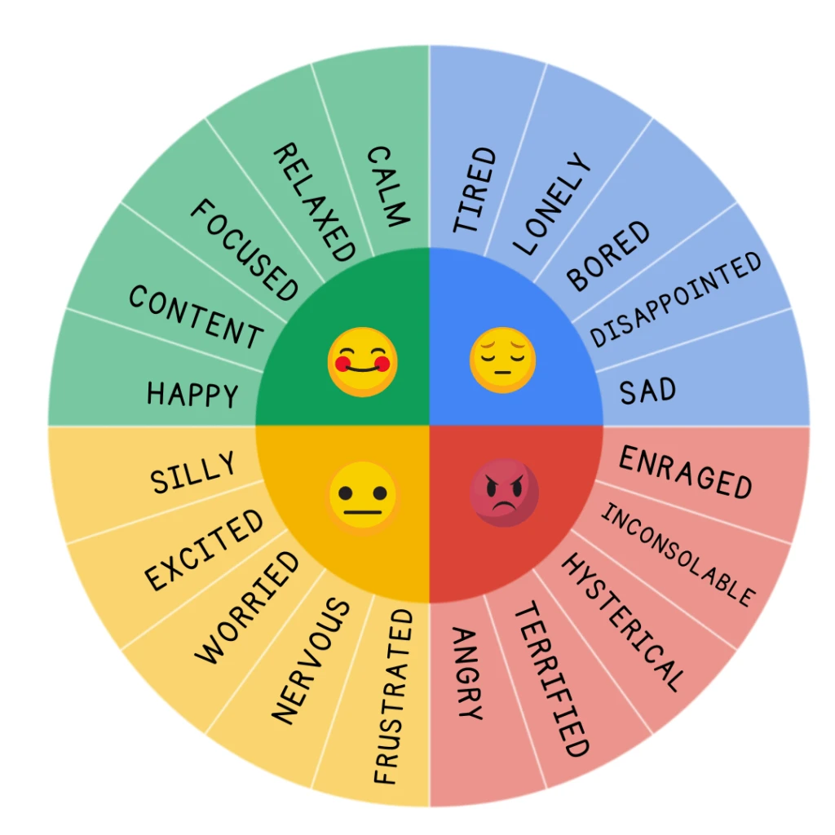
How are you feeling today?
Let us know how you’re feeling today.

Slide 3

Agenda
Self-examination
Exploring skills the mentor and mentee bring to the relationship
Skills necessary for mentors and mentees
Power exchange and support
Generational differences
Session wrap-up
Notes:
Please note that Four C’s, Building Trust, and Connecting fall under the second bullet point in the agenda

Slide 4

Self-Examination
Key areas to consider in a self-examination in mentoring:
1. Active Listening
2. Empathy
3. Goal Setting
4. Direction
5. Feedback Delivery
6. Knowledge Sharing
7. Mentoring Style
8. Availability
9. Accessibility
10. Professional Development Opportunities
Notes:
For mentors:
How effectively have you set clear expectations and goals with your apprentice?
Are you providing sufficient opportunities for your apprentice to ask questions and seek advice?
Do you feel you are actively listening and providing constructive feedback?
Have you been able to effectively share your knowledge and experience?
How can you further tailor your mentoring approach to better support your mentee's specific needs?
For apprentices:
Are you actively engaging in the mentoring relationship by preparing for meetings and asking thoughtful questions?
Do you feel comfortable openly sharing your challenges and concerns with your mentor?
Are you taking initiative to apply the feedback and guidance provided by your mentor?
How well are you achieving the goals you set for your mentoring relationship?
What areas could you improve to maximize the benefits of your mentorship?
In the chat, share one area in which you feel highly effective and one area in which you feel you need growth.

Slide 5

Exploring Skills
When exploring skills in mentoring programs, key areas to focus on include:
Four C's
Building Trust
Connecting

Slide 6

Four c's
The Four C's in mentoring include:
Connection
  We will discuss Connection today. The other C’s will be explained further in a future webinar.
Correction
Counsel
Champion
Notes:
Effective mentoring programs have the capacity to transform lives and foster a culture of continuous learning and improvement. The Four C's of mentorship include counsel, correction, connection, and champion.
Counsel: (Guiding the Way) Mentors provide guidance by sharing their knowledge, helping mentees set achievable goals and offering strategies to overcome obstacles. Effective counseling is not just about giving answers; it's about asking the right questions to stimulate critical thinking and empower mentees to make informed decisions.
Correction: (Nurturing Growth) Mentors can provide correction effectively by setting clear expectations, offering specific examples, and providing actionable expert advice for improvement. They should also create a safe, non-judgmental space for mentees to share their challenges and concerns.
Connection: (Building Trust) To establish meaningful connections, mentors should actively listen to their mentees, seeking to understand their learning goals and concerns and organizing meetings. They should demonstrate empathy, showing genuine care for the mentee's well-being and long-term development.
Champion: (Advocating for Success) Mentors act as champions by identifying growth opportunities that align with their mentee's aspirations and advocating on their behalf.
What are the 4 cs of mentorship: A comprehensive guide. Qooper Mentoring Software: #1 Ranked Online Mentorship Platform. (n.d.). https://www.qooper.io/blog/4-cs-of-mentorship

Slide 7

Check for understanding
Think about how you connect with your apprentice.
Share what is one important aspect that makes connecting with your apprentice work?

Slide 8
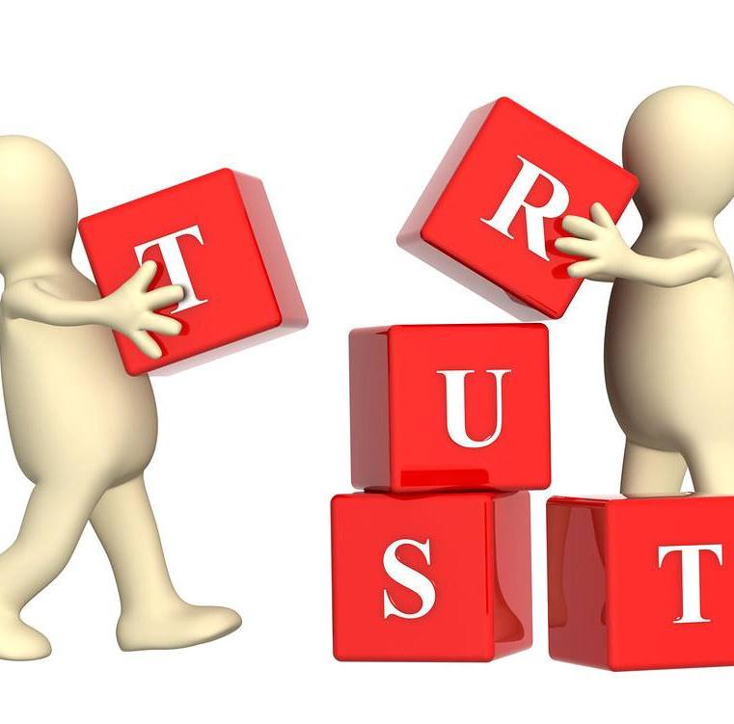
Building Trust
"Trust is the highest form of human motivation. It brings out the very best in people."
-Steven Covey
Notes:
Building trust is about laying the foundation for any relationship by demonstrating character.
(safety produced by honesty and transparency)
Building trust is about laying the foundation for any relationship through reliability.
(underpromise/overdeliver, say no, and use organizational rituals)
Building trust is about laying the foundation for any relationship by demonstrating competance.
(skills, knowledge, and credibility)
Building trust is about laying the foundation for any relationship through warmth.
(listen, demonstrate empathy, show positive attention, be vulnerable)
Building trust is about laying the foundation for any relationship by choosing stewardship.
(focus on others, communicate, give others credit, and care)

Slide 9

Connection
Connecting includes:
Strengthening Relationships
Emotional Connections
Witness to the Good
Notes:
From Better Conversations, (2016) Chapter 6
Connecting is about strengthening our relationships by making emotional connections and by being a witness to the good.
Emotional connections include making bids, responding to bids, and being fully present. Turn toward, turn away, or turn against. The bid is the fundamental unit of emotional communication. It can be a question, a look, or a single expression that shows that one wants to be connected. (p. 107)
Witness to the good includes being direct, specific, and nonattributive. One of the simplest and most powerful ways to build emotional connections is by sharing positive information with others. (p. 115)

Slide 10
Power Exchange and Support between Mentor and apprentice
This refers to the dynamic where a mentor, typically with more experience, provides knowledge and guidance to a mentee.
The mentee offers fresh perspectives, enthusiasm, and the opportunity for the mentor to solidify their own understanding by explaining concepts to someone else.
Both parties contribute and benefit from the relationship even though there is an imbalance due to the level of experience.
(Organized with Generative AI in Google Search)
Notes:
In a mentoring program, "power exchange" refers to the dynamic where a mentor, typically with more experience and seniority, provides guidance and knowledge to a mentee, while the mentee offers fresh perspectives, enthusiasm, and the opportunity for the mentor to refine their skills by sharing their expertise and potentially learning from the mentee's questions or challenges; essentially, both parties contribute to the relationship in different ways, creating a mutually beneficial exchange of power and knowledge.
Key topics about power exchange in mentoring:
· Unequal power distribution
· Positive power exchange
· Benefits for both parties
· Challenges to manage
· Power imbalance issues
· Lack of reciprocity
· Set clear expectations
· Foster open communication
· Respect boundaries
· Focus on mutual growth

Slide 11
Check for understanding
Think about your mentor/apprentice relationship.
Share one or more examples of what you and your apprentice contribute to and benefit from the relationship.

Slide 12
Understanding Generational differences: What They want
Baby Boomers (1946 – 1964)
Gen X (1965 – 1979)
Gen Y, also known as Millennials, (1980 – 1995)
Gen Z (1996 – 2012)
Notes:
Generational differences mean that different generations have distinct values, communication styles and expectations from a mentor, with younger generations often preferring more flexible and informal mentoring approaches, while older generations may value structured guidance and traditional hierarchies requiring mentors to tailor their approach based on the mentee’s generation to be effective.
Boomers
Want to have their accomplishments, hard work and effort acknowledged
Want to be challenged. They are often looking for new ideas
Want to be respected and engaged in collaboration
Want to feel your interest in them.
Gen Xers
Want clear expectations and measures for success
Want regular communication and to be given feedback
Want answers to questions and support given just-in-time support
Don't want to be micromanaged
Gen Yers
Want to be treated as equals
Want their thinking to be listened to
Want a relationship that is personal, fun, and engaging
Want goals broken into small pieces with realistic deadlines
Want regular feedback, especially praise and affirmation
Source: Zachary, 2016.

Slide 13

Generational Differences : For all generations
Do:
Give challenging work with opportunity for prestige
Expect hard work
Set expectations
Demonstrate your own competence
Provide support and suggestions
Treat them as equals
Let them have a voice
Provide opportunities for teamwork.
Paraphrased from The Mentor’s Guide by John Wiley & Sons, Inc.
Notes:
Descriptions about generational differences in mentoring include:
Baby Boomers (born 1946-1964)
Hard workers, like face-to-face communication, value structured mentoring programs, and clear career paths
Generation X (born 1965-1980)
Tend to be independent, value work-life balance, and prefer a more collaborative mentoring approach
Millennials (born 1991-1996)
Tech savvy, seek regular feedback, may value mentorship that focus on personal development and career growth, often prefer informal mentoring relationships
Generation Z (born 1997-2012)
Highly digital natives, prioritize diversity and inclusion and may expect mentors to be accessible and readily available through various communication channels
Do
For Boomers, give them challenging work with opportunity for prestige, focus on professional accomplishments, expect hard work, and make them feel special.
For Gen Xers, demonstrate your own competence, share information, ask for their opinion, set expectations, talk about end results, be collegial, provide recognition for individual achievements, and be technologically up to date.
For Millennials and Zs, tell them the truth, treat them as equals, acknowledge what they bring to the table, make the relationships fun, let them have a voice and a veto in the relationship, challenge and stretch their minds with a variety of assignments, provide opportunities for teamwork.

Slide 14

Check for understanding
Think about your mentor/apprentice relationship.
What is one generational difference that you experience with your apprentice?
Describe how you overcome that difference.

Slide 15
How are you feeling today?
How are you feeling about your current relationship with your apprentice?

Slide 16

Wrap-up
Next session:_______________
Location/Link:________________
Questions?

Slide 17

Resource Page
Community. competency. civility. Colorado Attorney Mentoring Program. (2024, November 25). https://coloradomentoring.org/
Garte, R., & Kronen, C. (2020). You’ve met your match: Using culturally relevant pairing to cultivate mentoring relationships during the early practicum experience of Community College Preservice Teachers. The Teacher Educator, 55(4), 347–372. https://doi.org/10.1080/08878730.2020.1799128
Knight, J. (2016). Connecting. In Better Conversations: Coaching Ourselves and each other to be more credible, caring, and connected. ( pp. 105 – 131. Corwin, A Sage Company.
Nolan, A., & Molla, T. (2016). Teacher professional learning in early childhood education: Insights from a mentoring program. Early Years, 38(3), 258–270. https://doi.org/10.1080/09575146.2016.1259212
What are the 4 cs of mentorship: A comprehensive guide. Qooper Mentoring Software: #1 Ranked Online Mentorship Platform. (n.d.). https://www.qooper.io/blog/4-cs-of-mentorship
Yoon, H. S., & Larkin, K. A. (2018). When tensions between ideology and practice become personal: Unpacking mentorship in early childhood teacher education. Journal of Early Childhood Teacher Education, 39(1), 50–72. https://doi.org/10.1080/10901027.2017.1404506
Notes:
Coun

Slide 18


Name, title, contact info

