Slide 1



Apprentice Orientation

Slide 2

Session Overview
Introductions
Why Early Childhood Education?
What is an Apprenticeship?
Early Childhood Education Registered Teacher Apprenticeship Program
Roles & Responsibilities
Questions & Answers

Slide 3

introductions
Reflect
Identify
Share

Slide 4

Breadth of the ECE Field
Work in groups of two to three people
Brainstorm all of the roles/jobs that make up the ECE field
List the roles/jobs on sticky notes
Roles in ECE

Slide 5
Breadth of the ECE Field
Home
Visitor
Federal
Technical
Assistance
Early
Interventionist
Family
Educator
Operations Manager
Child Care Coach
Trainer
Center
Director
Licensing
Consultant
Preschool Educator
Family
Child Care
Owner
Special
Education Educator
Mental
Health
Consultant
Infant Toddler Specialist
College
Professor
Assistant Teacher
State Administrator

Slide 6

Why ECE?
Why are you interested in working with young children?

Slide 7

What is an Apprenticeship?
Related Instruction
Supported On-the-Job Training
Paid Work Experience

Slide 8

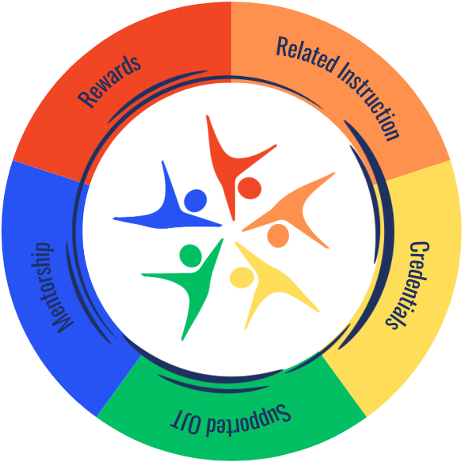

Slide 9
Related instruction
Principles | CTE Concentrator A | CTE Concentrator B | Pathway Capstone
Principles of Early Childhood Education | Early Childhood Education Curriculum | Early Childhood Education Guidance | Early Childhood Education Capstone

Slide 10
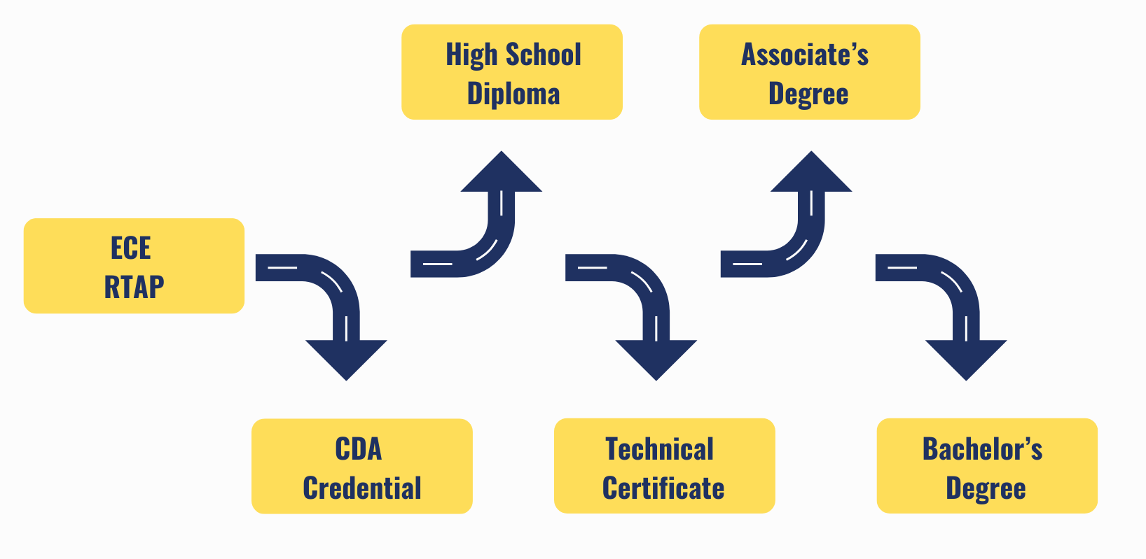

Slide 11

Child Development Associate Credential
Prepare
CDA Training
ECE Experience
Apply
Online Application
$425 fee - funding available
Demonstrate
Verification Visit
CDA Exam

Slide 12

Supported On-the-Job Training/Paid Work Experience
Concepts learned applied in a real-life environment
Work alongside a mentor educator
Earn a wage while gaining experience

Slide 13
ECE RTAP Competencies
Establishes and maintains a safe, caring, inclusive, and healthy learning environment.
Plans and implements intentional, developmentally, culturally, and linguistically appropriate learning experiences.
Observes, documents, and assesses children’s learning and development.
Develops reciprocal, culturally responsive relationships with families and communities.
Advances and advocates for a diverse and effective early childhood education profession.
Engages in reflective practice and continuous learning.
Meets the needs of all children by understanding and providing effective support.

Slide 14

What your mentor teacher will do for you During OTJ Learning
Modeling Best Practices
Coaching and Feedback
Monitoring Progress
Open Communication

Slide 15
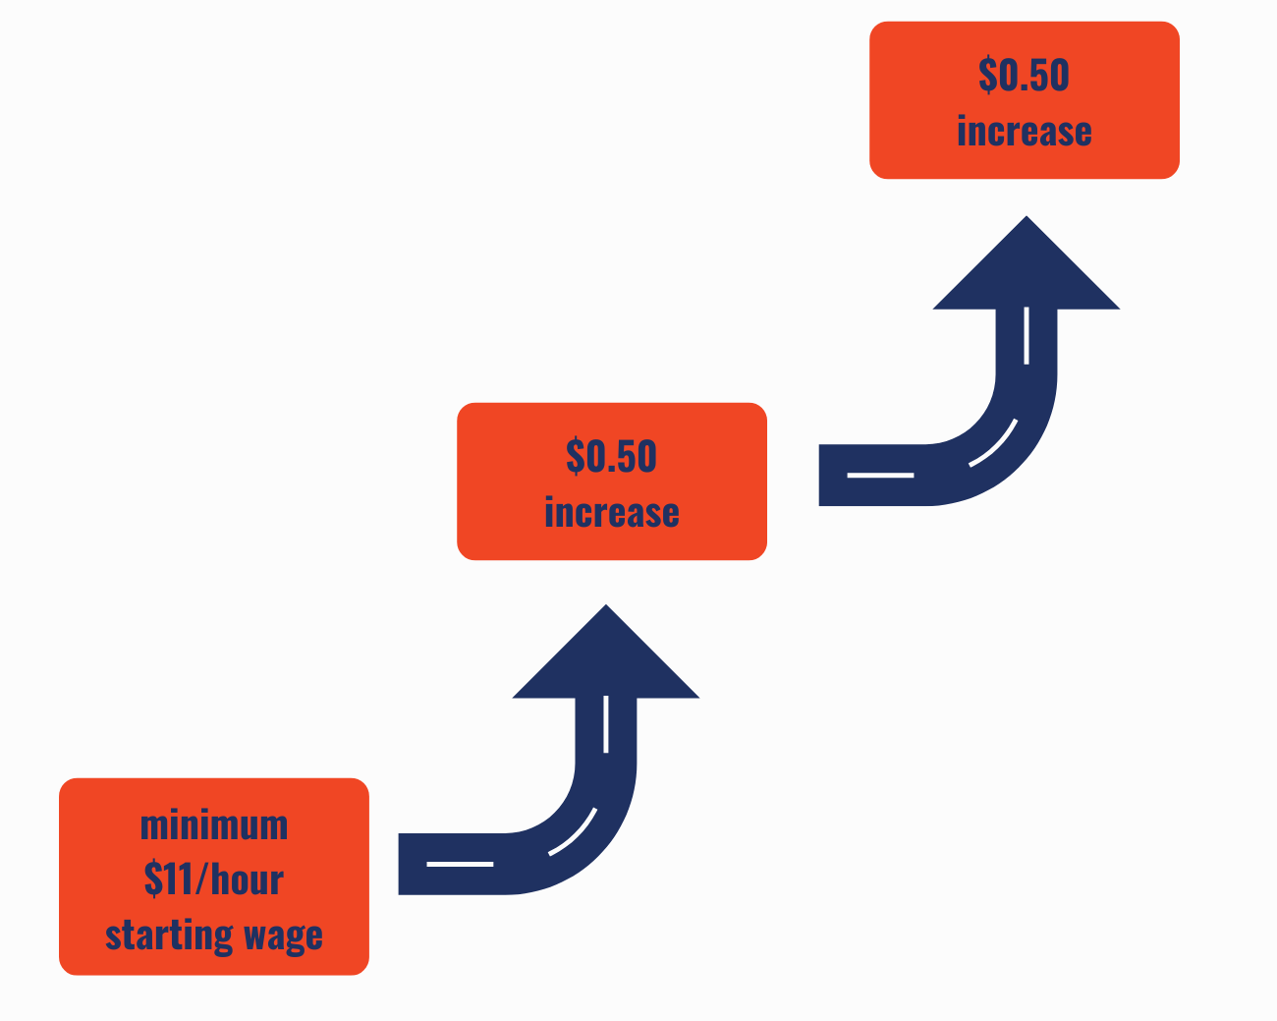
Rewards for Skills Gains and apprenticeship benefits
First wage increase happens upon 6 dual credits earned and 15 competencies mastered
Second wage increase happens upon 9 dual credits earned and 31 competencies mastered

Slide 16
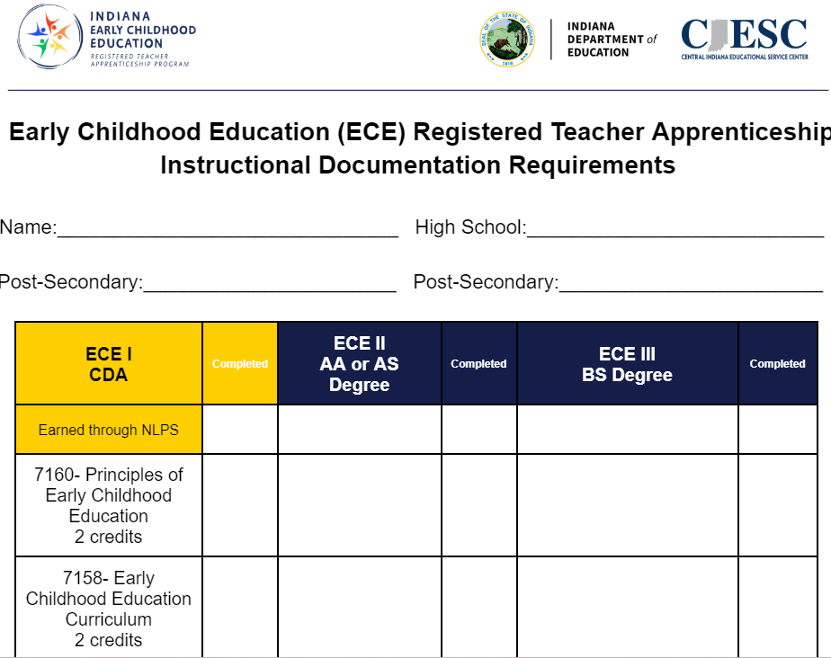
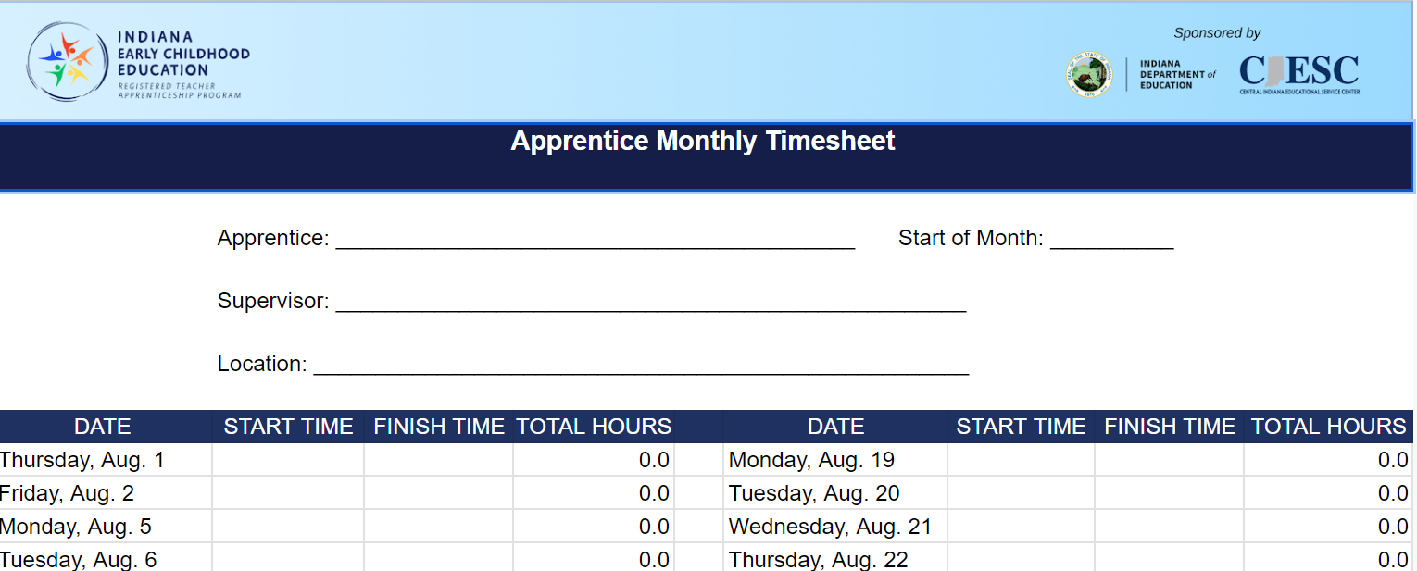
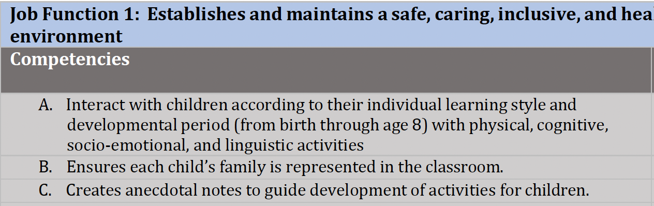
Apprentice Responsibilities and Documentation
Timesheet
Apprentices
Meet expectations
Complete coursework
Maintain records
Adhere to policies
Related Instruction
Competencies
Notes:
When are these docs due?

Slide 17
Mentor Responsibilities and Documentation
Mentors
Supervise OJT
Model skills
Provide coaching
Assess Apprentice

Slide 18
Next Steps for apprentices
Parent/Guardian Consent Form
Sign and submit
Department of Labor Documentation
Provide copies of social security card and one of the following: driver’s license, state identification card, passport or birth certificate
Sign and submit apprenticeship agreement form
Notes:
Update

Slide 19

Questions & Answers

Slide 20
Early childhood education apprenticeship team
Executive Director, ECE Pathways & Initiatives
Asst. Director, ECE Pathways & Initiatives, RAP and WBL
Dr. Kelli Servizzi
kservizzi@ivytech.edu
Traci Marshall
tmarshall134@ivytech.edu

