Slide 1

Community of Practice for Mentor Teachers
Session 6: Encouraging Growth
Notes:
Welcome to session # 5 of our Community of Practice! Today our focus is on negotiation the relationship between mentor and apprentice.

Slide 2

Agenda
Encouraging professional growth
Reflecting on practice
Session wrap-up
Notes:
Our agenda for today is to talk about encouraging growth; reflecting on practice; and our session wrap up.

Slide 3

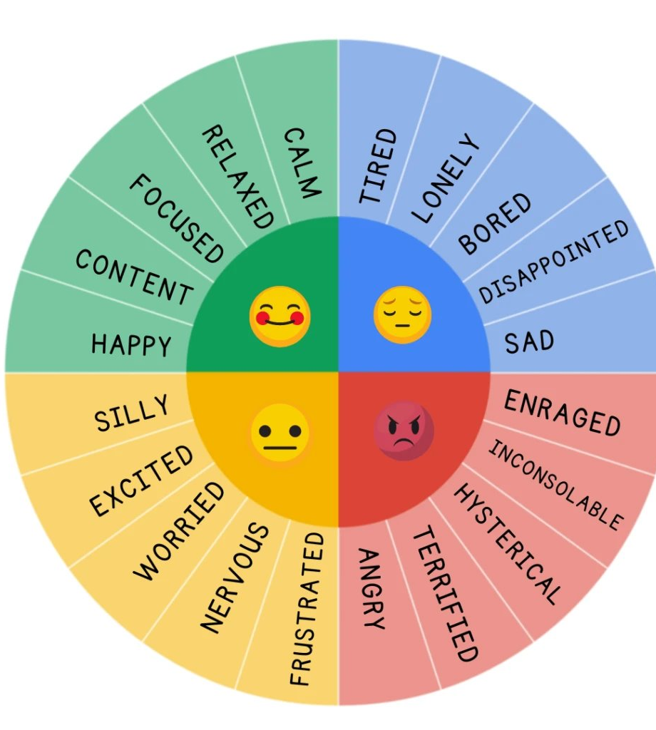
How are you feeling today?
Let us know how you are feeling about your apprentices' skills.
Notes:
Each month we've been asking how you feel. Today we'd like for you to identify in the chat how you are feeling about your apprentices' skills up at this point. You may provide a sentence of explanation if you so desire.

Slide 4

Encouraging Growth
Apprentices can grow professionally through continuing education, working with a mentor, and reflecting on their practice.
Notes:
This slide introduces the theme of this CoP. Professional growth is important for an apprentice because it allows them to acquire valuable skills and knowledge within their chosen field, enhancing their career prospects by making them more competitive in the job market, increasing their earning potential, and building a strong foundation for future advancement within their company or industry; this is often facilitated through mentorship and on-the-job training provided during the apprenticeship program.

Slide 5
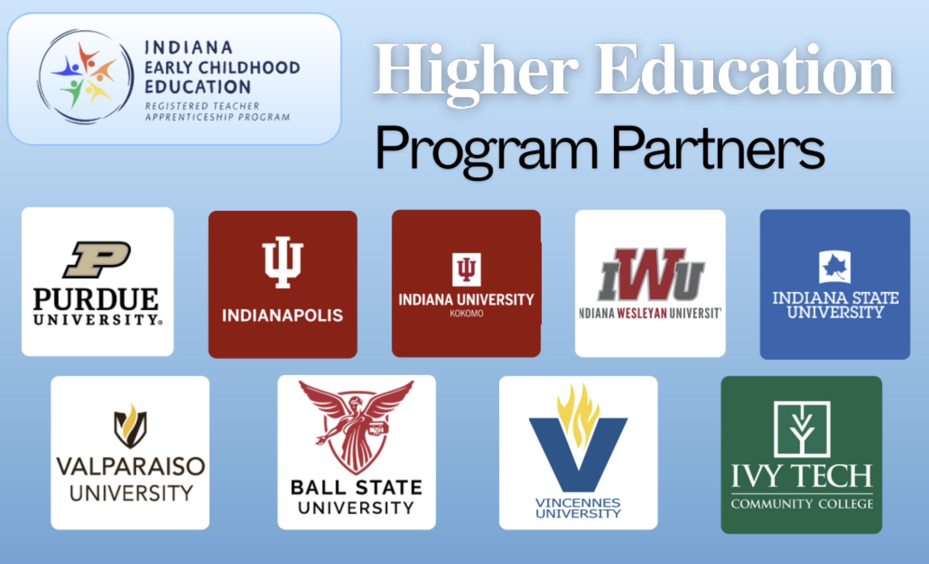

Continuing Education
Notes:
A. We will direct participants to the monthly competency tracker and explain competency 6.1 - Takes advantage of available opportunities for professional development and continuous learning.
B. As mentors, our role is to guide and support our apprentices in becoming skilled and knowledgeable early childhood educators. One part of their journey is completing essential training and education.
One way for apprentices to build a strong foundation is by taking courses at an accredited college or university. These programs provide structured learning and credentials that will serve them throughout their careers. As mentors, we can help by guiding them toward the right institutions and supporting them through the coursework. Relationships built with experts in colleges or universities can help apprentices network within the field.
Continuing education can take many forms, and we want to emphasize the incredible support available through the ECE RAP higher education partners. These institutions provide pathways for apprentices to advance their knowledge and skills. ECE RAP higher ed partners play a vital role in helping apprentices grow in their careers, ensuring they have access to quality education that aligns with the needs of the early childhood education field.
C. Apprentices must complete a set number of clock hours in child development or early childhood education training. This hands-on experience is essential for building practical skills. We can support them by helping track their progress, recommending quality training programs, and providing opportunities to apply what they learn in real classroom settings.
Remind them of timesheet
These clock hours contribute to CDA requirements:
120 hours of formal education/training in early childhood education (ECE) or child development.
Training must cover the eight CDA competency standards, which include:
Safe and Healthy Learning Environment
Physical and Intellectual Development
Social and Emotional Development
Relationships with Families
Program Management
Professionalism
Observing and Recording Behavior
Principles of Child Development and Learning
480 hours of professional work experience with children in the relevant CDA setting (Infant/Toddler, Preschool, Family Child Care, or Home Visitor) within the last 3 years.
Professional Portfolio including:
Reflective Statements of Competence
Family Questionnaires
Resource Collection (artifacts like lesson plans, parent communication samples, etc.)
A CDA Professional Development Specialist will conduct an observation of the candidate working with children.
Take and pass the CDA Exam (computer-based, 65 multiple-choice questions).
The CDA must be renewed every three years.
Renewal requires:
45 hours of additional professional development training.
A letter of recommendation.
Current CPR/First Aid certification.
D. Learning doesn’t stop after initial training. Encouraging apprentices to earn continuing education credits, or CEUs, ensures they stay up-to-date with best practices and new developments in the field. Suggesting workshops, webinars, and professional conferences can help them grow and thrive. Segue to next slide.

Slide 6
Continuing Education might look like . . .
Attending a local or state conference
Attending a local workshop or training
Pursuing an A.S. degree from Ivy Tech Community College
Pursuing a Bachelor’s degree from a four-year college or University
Remember: Continuing education can take many forms and doesn’t
necessarily mean taking college courses.
Notes:
Continuing education is an essential part of professional growth, and it doesn't always mean sitting in a college classroom. There are many ways your apprentices can further their knowledge and skills.
For example, they can attend a local or state conference to learn from experts and network with others in the field. Workshops and training sessions are also great opportunities to gain practical skills that they can apply immediately.
If they’re looking for a more structured educational path, they might consider pursuing an associate degree from Ivy Tech Community College or even a bachelor’s degree from a four-year college or university.
As mentors, it’s important to encourage apprentices to explore the best continuing education path for their goals. Every step they take toward learning and development strengthens their ability to succeed in the field!
Here are several great examples:
First,
show INAEYC Conference website (inaeyc.org). The upcoming Indiana Early Childhood Conference is scheduled for Friday and Saturday, at the Indiana Convention Center in Indianapolis.
This annual event brings together early childhood educators, administrators, and advocates to engage in professional development and networking opportunities.
Second,
show IDOE Learning Lab website (inlearninglab.com/resources)
The Indiana Department of Education (IDOE) Learning Lab is an online professional development platform designed to support Indiana educators with free resources, training, and collaboration opportunities. It provides access to on-demand courses, live webinars, instructional materials, and a community space for educators to connect and share best practices.
On-Demand Professional Development - Educators can access courses on various topics, including STEM, literacy, social-emotional learning, and more.
Live Webinars & Virtual Events - IDOE regularly hosts live training sessions to help educators stay updated on new strategies, policies, and tools
Resource Library - A collection of lesson plans, templates, and instructional strategies aligned with Indiana academic standards.
Collaboration & Networking - Educators can connect with peers, join discussion groups, and engage in professional learning communities.
Third, many employers provide professional development opportunities for their staff. As mentors, we need to encourage apprentices to attend these PDs. There are several ways for you to make your apprentice feel welcome at these events. First, send them an invitation. If the employer sends out emails and you notice your apprentice is not on the email list, make sure your apprentice knows. Second, attend the events with your apprentice. This eliminates any social barriers and will give you an opportunity to model how to apply knowledge from these events.

Slide 7

Working with a mentor
Taking the opportunity to ask questions to clarify your understanding of the competencies.
Developing your professional skills.
A different type of relationship instead of the typical teacher/student roles.
Notes:
These points listed above were shared in greater detailed in a previous CoP. (Add benefits of working with a mentor)
We will direct participants to the monthly competency tracker and explain competency 6.2 - Openly receives critique and feedback from mentor and supervisors and improves practice under guidance of mentor.
share the competency tracker
This competency is crucial because growth comes from being open to feedback and making intentional improvements. As mentors, our role is to provide constructive feedback and create a space where apprentices feel supported in refining their skills. Encourage them to see feedback as an opportunity, not a setback.

Slide 8

Working with a mentor might look like . . .
The Apprentice should be encouraged to ask questions, and the Mentor should encourage questions.
This is a prime opportunity for the Apprentice to practice developing professional skills.
The Mentor is a guide not necessarily providing new content to be learned.
Notes:
The Apprentice should be encouraged to ask questions, and the Mentor should encourage questions.
This is a prime opportunity for the Apprentice to practice developing professional skills.
The Mentor is a guide not necessarily providing new content to be learned.

Slide 9

Becoming a Reflective practitioner
Notes:
Focus on competency 6.2 – Openly receives critique and feedback from mentor and supervisors and improves practice under guidance of mentor.
Part of the role of the mentor is to help their apprentice to become a reflective practitioner. A reflective practitioner is someone who regularly reviews their work and processes to identify areas for improvement. They are open to learning from their experiences and the experiences of others.

Slide 10

Becoming a Reflective Practitioner Can Look like . . .
Apprentice self-reflection form.
Reflective journaling.
Verbal reflection about the day’s activities with colleagues who share your learning environment.
Solitary reflection about the day’s activities.
Making notes regarding questions about things that happened.
Notes:
One of the most important habits we can help our apprentices develop is becoming a reflective practitioner. Reflection isn’t just about identifying areas for improvement—it’s also about recognizing and celebrating what went well. Remind your apprentice that this journey is a continual learning experience, and reflection is a valuable tool for growth. Encourage them to engage in different forms of reflection, such as:
Reflective journaling – Writing down thoughts, successes, and challenges to track progress over time.
Verbal reflection – Discussing the day’s activities with colleagues to gain new perspectives and insights.
Solitary reflection – Taking time alone to think about what worked, what didn’t, and how to improve.
Making notes about questions – Jotting down uncertainties or curiosities to revisit later for deeper understanding.
By incorporating these habits into their daily routine, apprentices will develop a stronger sense of self-awareness and professional growth.

Slide 11
Check for Understanding
Continue their education.
Identify areas for improvement.
Become a reflective practitioner.
All of the above.
How can you encourage your apprentice to grow professionally?
Notes:
Answer is D.
We will ask mentors for examples of A, B, and C.

Slide 12
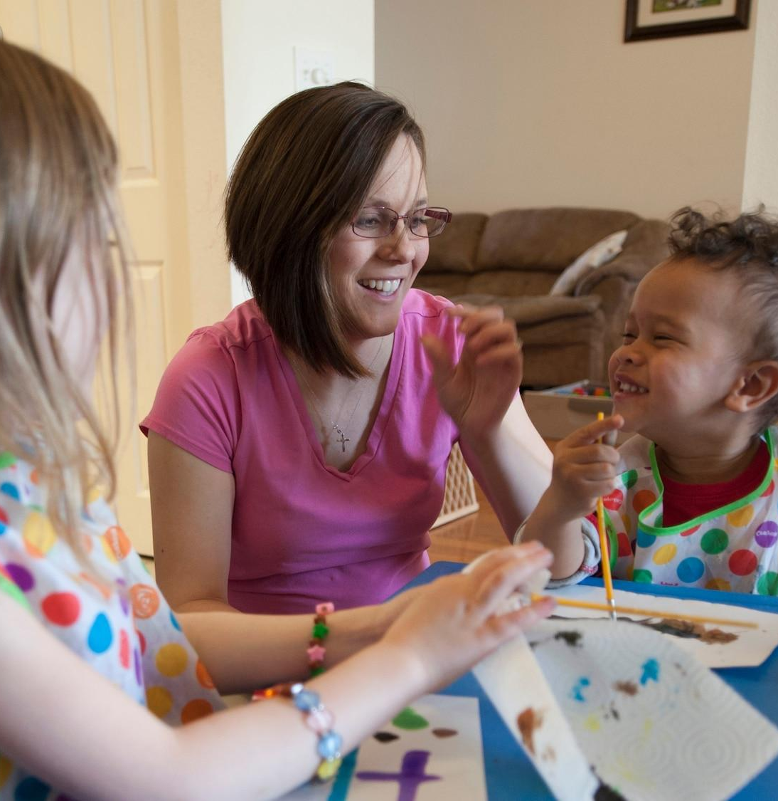
Model research-based teaching strategies
Set clear learning objectives.
Provide active learning.
Differentiate instruction.
Provide positive feedback.
Notes:
As mentors, one of our key responsibilities is to model effective, research-based teaching strategies for our apprentices. They need to understand not only what good teaching looks like but also why these strategies are effective.
Make sure your apprentice is clear on expectations for planning and implementing activities by focusing on these core strategies:
Set clear learning objectives - Ensure that students (and the apprentice) know what they are working toward and why it matters.
Provide active learning - Engage students with hands-on activities, discussions, and problem-solving rather than passive listening.
Differentiate instruction - Adapt lessons to meet the diverse needs of students, whether through scaffolding, varied resources, or flexible grouping.
Provide positive feedback - Encourage student growth by reinforcing strengths and offering constructive guidance for improvement.
By modeling these strategies consistently, we help apprentices build strong instructional habits that will serve them throughout their teaching careers.
Teaching strategies are included throughout the competency tracker:
Job Function 1: Supports the learning and development of young children
1.1 Interacts with children according to their individual learning style and developmental period
1.3 Creates anecdotal notes to guide development of activities for children
Job Function 2: Plans and implements intentional, developmentally, culturally, and linguistically appropriate learning experiences
2.1 Collaborates with other early childhood educators in the development and implementation of early learning activities
2.2 Provides supports to help ensure children engage in activities with small groups and whole group
2.3 Reads, begins to understand, and follows state early learning guidelines, guidance from Head Start, public pre-K, and elementary education
2.4 Supports purposeful play in the environment with a focus on learning
2.5 Works towards planning learning activities that allow all children to feel included
Job Function 3: Observes, documents, and assesses children's learning and development
3.1 Supports the assessment of each child in the classroom by completing anecdotal notes
3.3 Uses approved assessments accurately and ethically
3.4 Tracks children’s developmental and academic progress

Slide 13
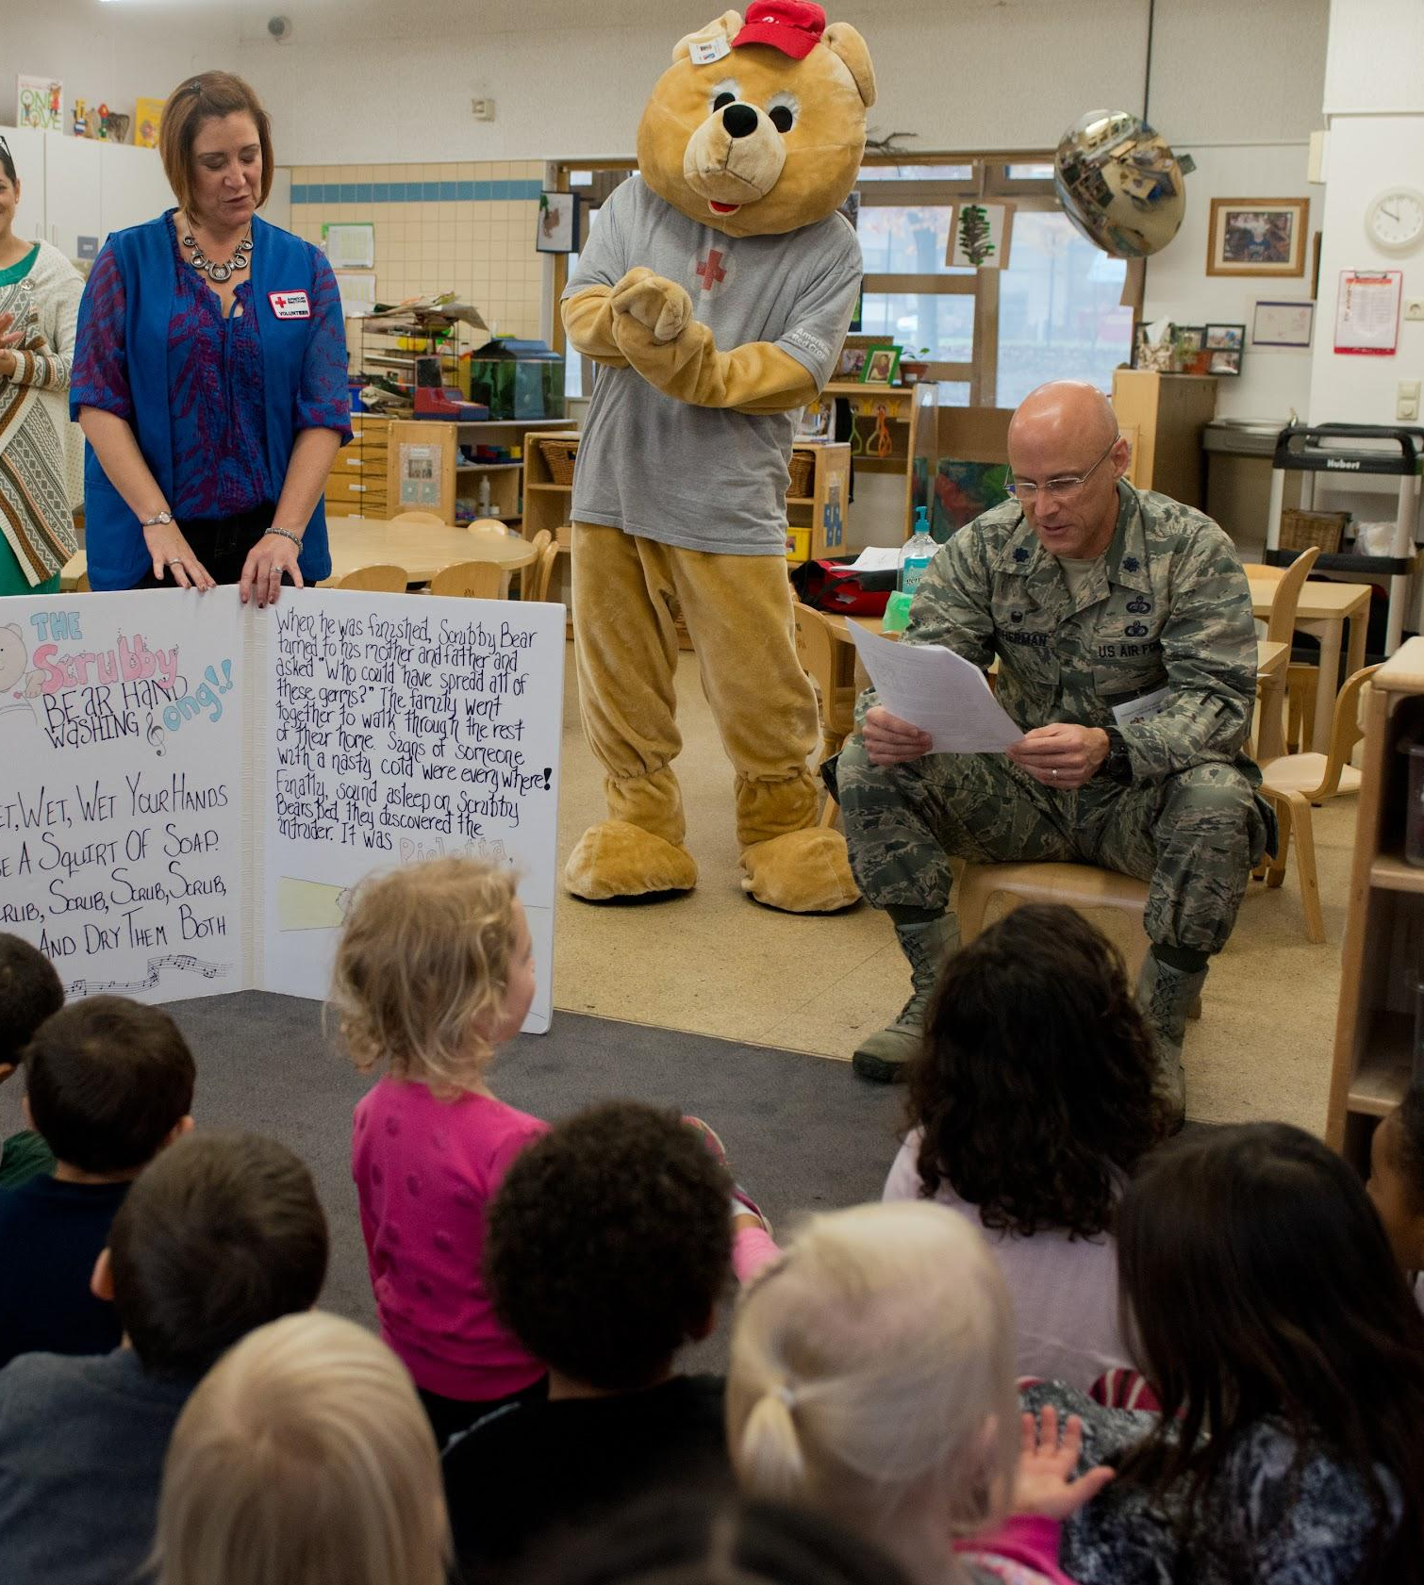
Model Student-centered teaching methods
Get to know children’s backgrounds, interests, and experiences.
Create a welcoming environment and promote respect.
Make curriculum relevant.
Involve families and communities.
Notes:
We will direct participants to the competency tracker and explain competencies 4.1, 4.2 and 4.3:
Job Function 4:Develops reciprocal, culturally responsive relationships with families and communities Competencies Mentor Initials Date teachers.
A. Learns about each child’s cultural backgrounds.
B. Respects and values parents/caregivers as children’s first teachers.
C. Supports collaborative relationships with co-workers and service providers working with children.
We will also include competency 1.2 – Ensures each child’s family is represented in the classroom.

Slide 14
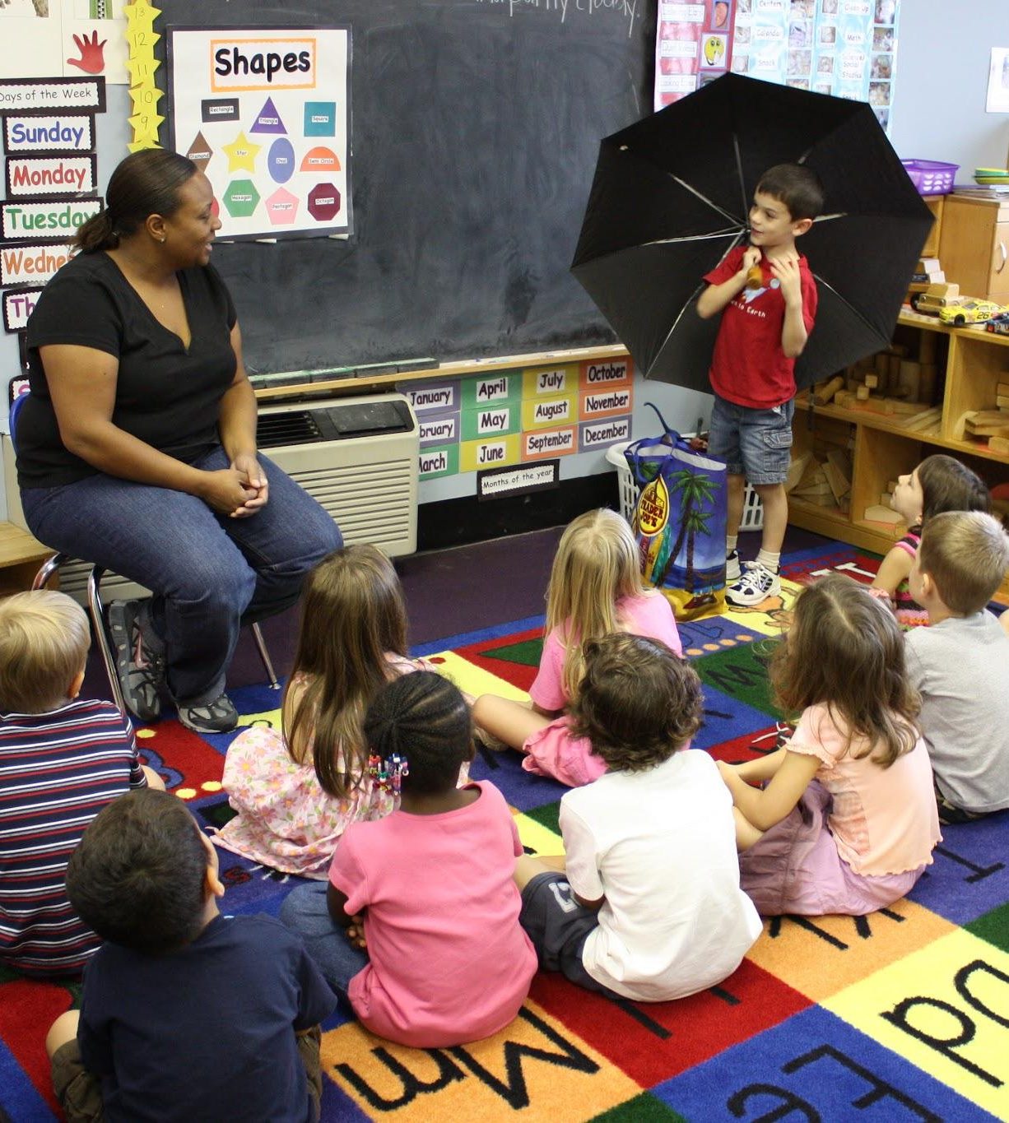
Enhance Student wellbeing
A “morning meeting” can align with the following competencies:
1.1
1.5
2.2
2.5
Notes:
Give an example of a morning meeting.
Related competencies:
1.1 Interacts with children according to their individual learning style and developmental period (from birth through age 5) with physical, cognitive, student wellbeing, and linguistic activities.
1.5 Acclimates children to the early learning environment so the transition between home and school is smooth. This includes assisting the child in developing social skills to get along with other children and emotional regulation to adjust to being away from home.
2.2 Ensure individual activities are created based on child’s unique development determined by anecdotal notes and assessments.
2.5 Works towards planning learning activities that allow all children to feel included.

Slide 15
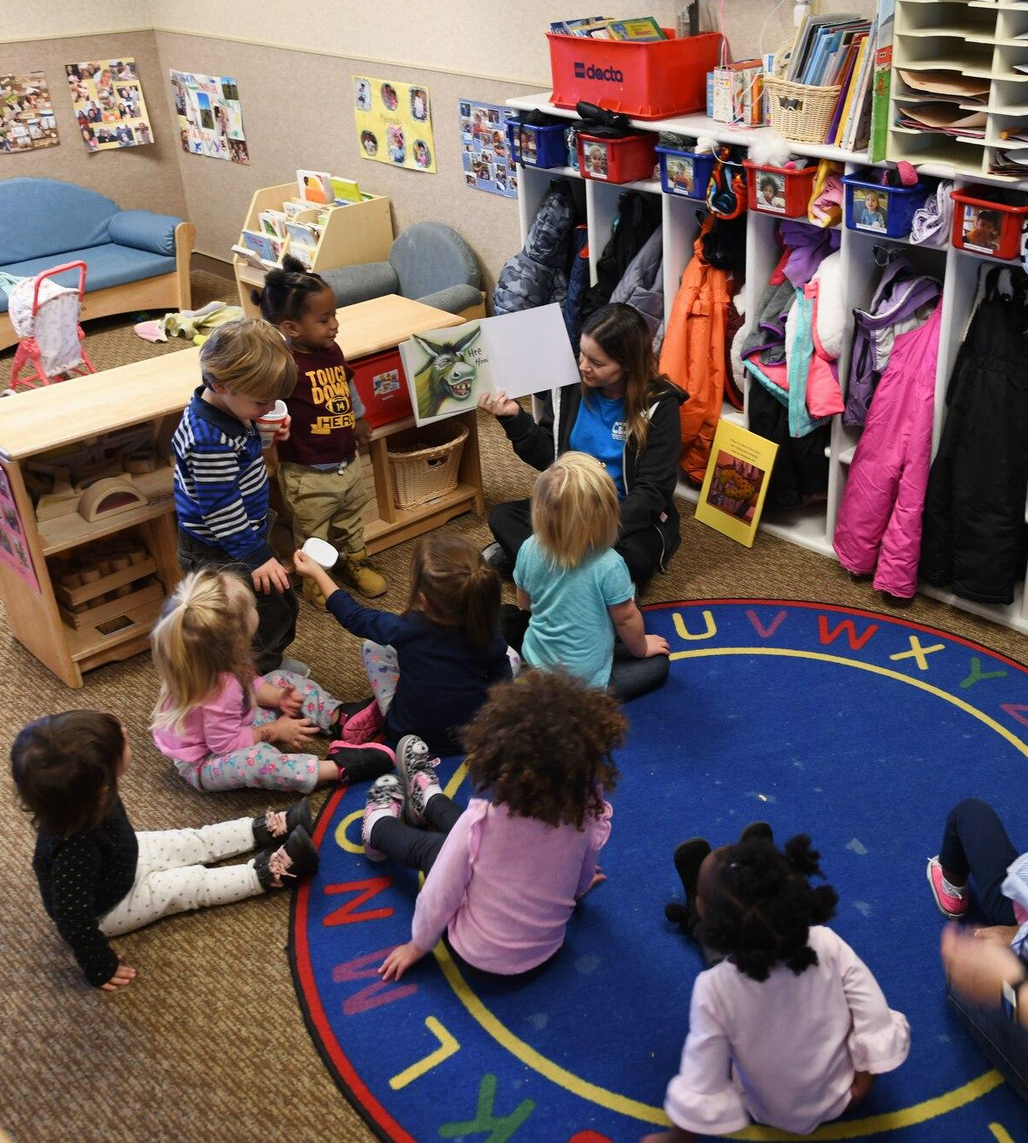
Check for understanding
Which of the following would help your apprentice enhance student wellbeing in the classroom?
A. Check-in with children during the morning meeting.
B. Make curriculum relevant.
C. Differentiate instruction.
D. None of the above.
Notes:
The answer is A.
Name some other ways to help children with learning about student wellbeing.

Slide 16

Encourage your Apprentice to Be Mindful of their own Actions
Observe your thoughts and emotions
Focus on the present moment
Body awareness
Mindful communication
Notes:
We will share Competency 6.3 – Models compassion and discuss.
As mentors, we want to guide our apprentices in developing self-awareness and intentionality in their practice. Encouraging mindfulness can help them stay present, regulate emotions, and build positive relationships with children and colleagues.
Remind them to:
Observe their thoughts and emotions - Recognize reactions without judgment.
Focus on the present moment - Be fully engaged with students and tasks.
Practice body awareness - Notice posture, energy levels, and stress signals.
Engage in mindful communication - Listen actively and respond with intention.
We will also introduce Competency 6.3 - Models compassion, emphasizing how mindfulness supports empathy, patience, and thoughtful responses in the learning environment.

Slide 17
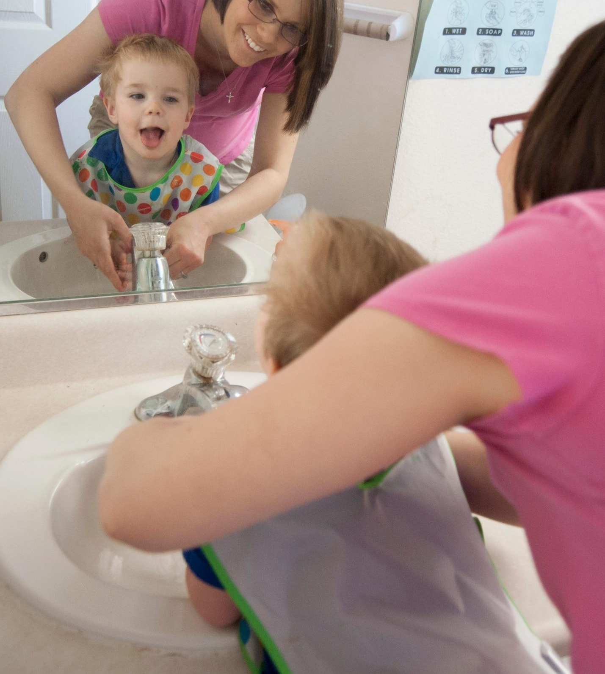
Adhere to workplace standards
Related competencies:
1.7
2.3
6.4
Notes:
Competency 1.7 - . Complieswithstatelicensingrequirementsandcompanypolicieswithregard to safety (health, cleaning, sanitation).
Competency 2.3 - Reads, understands, and follows state early learning guidelines, guidance from Head Start, public pre-k, and elementary education, and privately- owned childcare.
Competency 6.4 – Maintains effective communication in a professional manner with peers, supervisors, parents, and community.

Slide 18
Final thoughts:
Use your own experiences to help your apprentice in their journey.
What continuing education was most helpful to you?
Did you have a mentor at the beginning of your career?
How are you a reflective practitioner?
Notes:
This is the summary of this session. It may be helpful to use these questions to model professional growth for your apprentice.

Slide 19

Wrap-up
Next session:_______________
Location/Link:________________
Questions?

Slide 20
Resource Page
Abrams, J.B. (2009) Having hard conversations. Corwin.

Slide 21

Name, title, contact info

