Slide 1

Community of Practice for Mentor Teachers
Session 7: Wrapping up the Relationship
Notes:
Welcome to CoP Sesseion # 7 which will focus on Wrapping up the Mentor/Apprentice Relationship

Slide 2

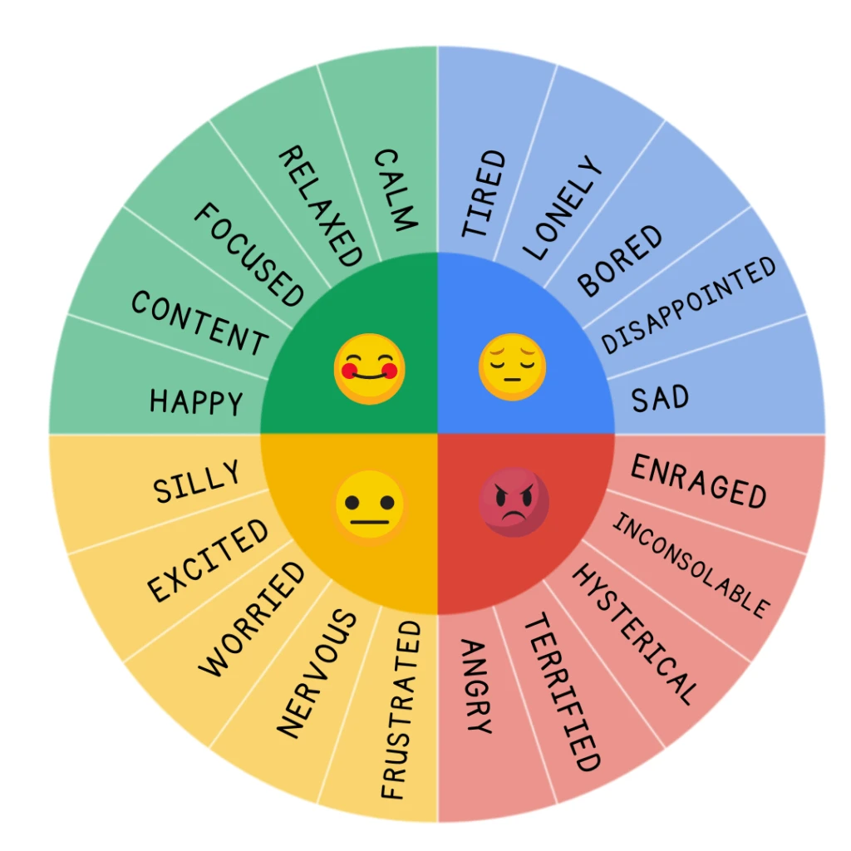
How are you feeling today?
Let us know how you’re feeling about your experience as a mentor.
Notes:
Let us know in the chat how you’re feeling about your experience as a mentor.

Slide 3

Agenda
Closure Steps and Action Strategies
The need for closure.
Discuss the best‐ and worst‐case scenarios.
Decide how to structure the closure conversation.
Focus on the application of learning and next steps.
Identify meaningful ways to celebrate the learning and express appreciation.
Notes:
The agenda for this session includes Closure Steps and Action Strategies. This includes the following:
The need for closure.
Best- and worst-case scenarios.
How to structure the closure conversation.
The application of learning and next steps.
● Identifying meaningful ways to celebrate the learning and express appreciation.

Slide 4
The need for closure
Think about a time when a work relationship ended. This could be a colleague moving to a new job; the retirement of a colleague; someone getting fired; or even you leaving your position.
How did you process this change? Did you have an opportunity to say goodbye to the individual? If so, how? If not, why not?
Now consider your relationship with your apprentice. How might they feel if you don’t bring the relationship to a close? How might you feel?
The goal of today’s session is to close the mentor/ apprentice relationship so that both of you are comfortable with its ending.
Adapted from Zachary, L. J. (2012). The Mentor’s Guide. Jossey Bass.
Notes:
Think about a time when a work relationship ended. This could be a colleague moving to a new job; the retirement of a colleague; someone getting fired; or even you leaving your position.
How did you process this change? Did you have an opportunity to say goodbye to the individual? If so, how? If not, why not?
Now consider your relationship with your apprentice. How might they feel if you don’t bring the relationship to a close? How might you feel?
Most mentoring relationships don't have the kind of closure we are talking about here. Certainly, the mentee may have achieved their learning goals, and the mentoring partners may feel they have ended on a high note; but because they did not plan for closure from the beginning, they have lost the opportunity to capitalize on learning and enrich the entire experience. The time to agree on the closure process is when you are negotiating the mentoring partnership agreement as part of the relationship ground rules (Zachary, 2012).
The goal of today’s session is to close the mentor/ apprentice relationship so that both of you are comfortable with its ending.
It is essential to plan the process of coming to closure, taking into consideration how it will play out both when closure is anticipated and when it is not. Using the learning goals of the mentoring relationship as a focal point provides a basis for discussing best‐case and worst‐case closure scenarios. Identifying potential stumbling blocks such as avoidance of closure or continuation of the relationship when one or both partners are unhappy makes it easier to plan how to overcome them.
Formal mentoring programs help facilitate the process of coming to closure because structures for reviews and end dates are usually specified. Mentors in informal mentoring relationships have to be more conscientious about bringing a mentoring relationship to closure because there is no prescribed end date.
Virtual closure offers a welcome opportunity for closure when meeting in person to bring a relationship to closure is not timely, convenient, or practical. Once you acknowledge the need for closure, you will need to establish a process that will help you end on a positive note and identify a framework for organizing a “learning conclusion” conversation—a highly focused conversation about learning outcomes that have resulted from the mentoring relationship. On the next slide we will look at two examples of what can happen when closure is planned for.

Slide 5
Discuss the best‐ and worst‐case scenarios.
Was this an appropriate way to close the mentor / apprentice relationship? Why or why not? | Yes | No
The mentor reviews the final checklist with the apprentice and ends the meeting by saying, “You’ve learned a great deal and can demonstrate new skills. Please keep in touch. Goodbye.” The apprentice leaves the meeting wondering if they will ever be in contact with their mentor again.
The mentor reviews the final checklist with the apprentice. The mentor then asks the apprentice, "While our formal relationship is over, I'm wondering if or how you would like to keep a connection in the weeks ahead. What are your thoughts?"
Notes:
Read the first scenario, then ask the participants to respond in the chat with a yes or no response. Mention why this is a best-or worst-case scenario and why.
This is a worst-case scenario because it is not specific regarding the apprentice’s learning and “Please keep in touch. Goodbye" is quite vague. It does not convey if the mentor really wants to keep in touch the with apprentice or if they are dismissing the apprentice.
Read the second scenario, then ask the participants to respond in the chat with a yes or no response. Mention why this is a best-or worst-case scenario and why.
This is a best-case scenario because the mentor is asking the apprentice if they want to stay in touch with their mentor allowing the two of them to come to a joint conclusion regarding the closure of the Mentor/Apprentice relationship.

Slide 6
Decide how to structure the conversation closure.
Closure Preparation Step | Related Questions
1.Revisit your purpose. | What was the goal in working together?
2.Envision a best-case scenario for closure. | What would we ideally like to see happen when this mentoring relationship ends?
3.Envision a worst-case scenario for closure. | What might get in the way of a positive learning conclusion?
4.Plan for mutual accountability. | What will we do to overcome any factors that get in the way of reaching a learning conclusion?
5.Establish a process for acknowledge the time for closure. | Is the final quarterly progress review appropriate for ending the relationship? Is another time better to do this?
6.Establish ground rules for the learning conclusion conversation. | What will our agenda be for our learning conclusion conversation?
Adapted from Zachary, L. J. (2012). The Mentor’s Guide. Jossey Bass.
Notes:
Just as beginning the mentor / apprentice relationship was planned by setting ground rules and expectations, so too closure of the relationship should be planned and set the tone for future expectations. The steps provided in this table are meant to guide you in your thinking about how to appropriately end the formal mentor / apprenticeship relationship. This does NOT mean that the mentor and apprentice cannot maintain a friendship or professional relationship. Instead, it signals that one type of relationship is ending and another is beginning (or not continuing).
To avoid the potential for a not-so-great ending, this table will assist you in planning for your closure.
1.Revisit your purpose. What was the goal in working together? (This is a good time to look back at the competencies the apprentice was expected to master.
2.Envision a best-case scenario for closure. What would we ideally like to see happen when this mentoring relationship ends?
3.Envision a worst-case scenario for closure. What might get in the way of a positive learning conclusion?
4. Plan for mutual accountability. What will we do to overcome any factors that get in the way of reaching a learning conclusion?
5. Establish a process for acknowledge the time for closure. Is the final quarterly progress review appropriate for ending the relationship? Is another time better to do this?
6. Establish ground rules for the learning conclusion conversation. What will our agenda be for our learning conclusion conversation?

Slide 7

Check for understanding
Please share one step in the planning process that you think might be easily overlooked?
How will you make sure this step is not forgotten?

Slide 8
Focus on the application of learning and next steps
Mentor | Apprentice | Next Steps (for both)
Acknowledge the apprentice’s growth. Be specific. | Feel good about how far you’ve come! | Be aware of where skill improvement is still needed.
Acknowledge how you have grown as a mentor. | Tell the mentor how you feel they have improved. | Consider what you would do differently the next time.
Encourage the apprentice to continue developing their skills. | Plan to be a life-long learner. | How will you continue to develop your skills?
Notes:
Review the information provided in this table.

Slide 9
Identify meaningful ways to celebrate the learning and express appreciation.
Rekindle memory.
Appreciate.
Talk about transitions.
Collaborate on planning.
Elevate and expand knowledge.
Expand your thinking.
Brag about accomplishments.
Adapted from Zachary, L. J. (2012). The Mentor’s Guide. Jossey Bass.
Notes:
Collaborate on planning. Encourage the apprentice to assist with planning how you will celebrate.
Elevate and expand knowledge. Use the opportunity to continue the learning. For example, how is this celebration similar to a celebration for children? How is it different?
Expand your thinking. What will make this celebration meaningful?
Brag about accomplishments. Celebrate big accomplishments!
Rekindle memory. Reflect on the beginning of the journey and how learning and relationships have changed.
Appreciate. Let your apprentice know what it is about them that you appreciate.
Talk about transitions. Change will occur. What can be done to make it go smoothly?

Slide 10

Check for understanding
Please share how you might celebrate your apprentice’s learning.
What new thoughts do you have about a celebration of learning?
Notes:
Please share in the chat how you might celebrate your apprentice’s learning.
What new thoughts do you have about a celebration of learning?
Allow time for participants to respond as they may not have given much thought to this.

Slide 11
Ending a relationship when the mentoring ends
There may be a time when a mentor / apprentice relationship has
experienced a problem, but reaching a learning conclusion can still allow
both individuals to leave the experience on a positive note.
Here are a few suggestions:
Name the problem without casting blame or passing judgement.
Make a clean break if you decide not to continue the relationship and
end on an upbeat note.
3. Express mutual appreciation.
Adapted from Zachary, L. J. (2012). The Mentor’s Guide. Jossey Bass.
Notes:
There may be a time when a mentor / apprentice relationship has experienced a problem, but
reaching a learning conclusion can still allow both individuals to leave the experience on a positive note.
Here are a few suggestions:
1. Name the problem without casting blame or passing judgement. For example, say, “While you may
have felt that you received feedback well (Competency 6.2), there were times when I felt I wasn’t
being heard. However, your commitment to continuing professional development does show your
willingness to continue learning.
2. Make a clean break if you decide not to continue the relationship and end on an upbeat note.
For example, you can say, “This has been a learning experience for both of us and it’s okay that we
didn’t become friends; however, I hope to see you at future professional events.”
3. Express mutual appreciation. Recognize the accomplishments that were made during the relationship.
You could say, “Although you may be disappointed that you didn’t reach the proficient level in all
competencies, we did make progress in every one of them! You should feel good about that!”

Slide 12
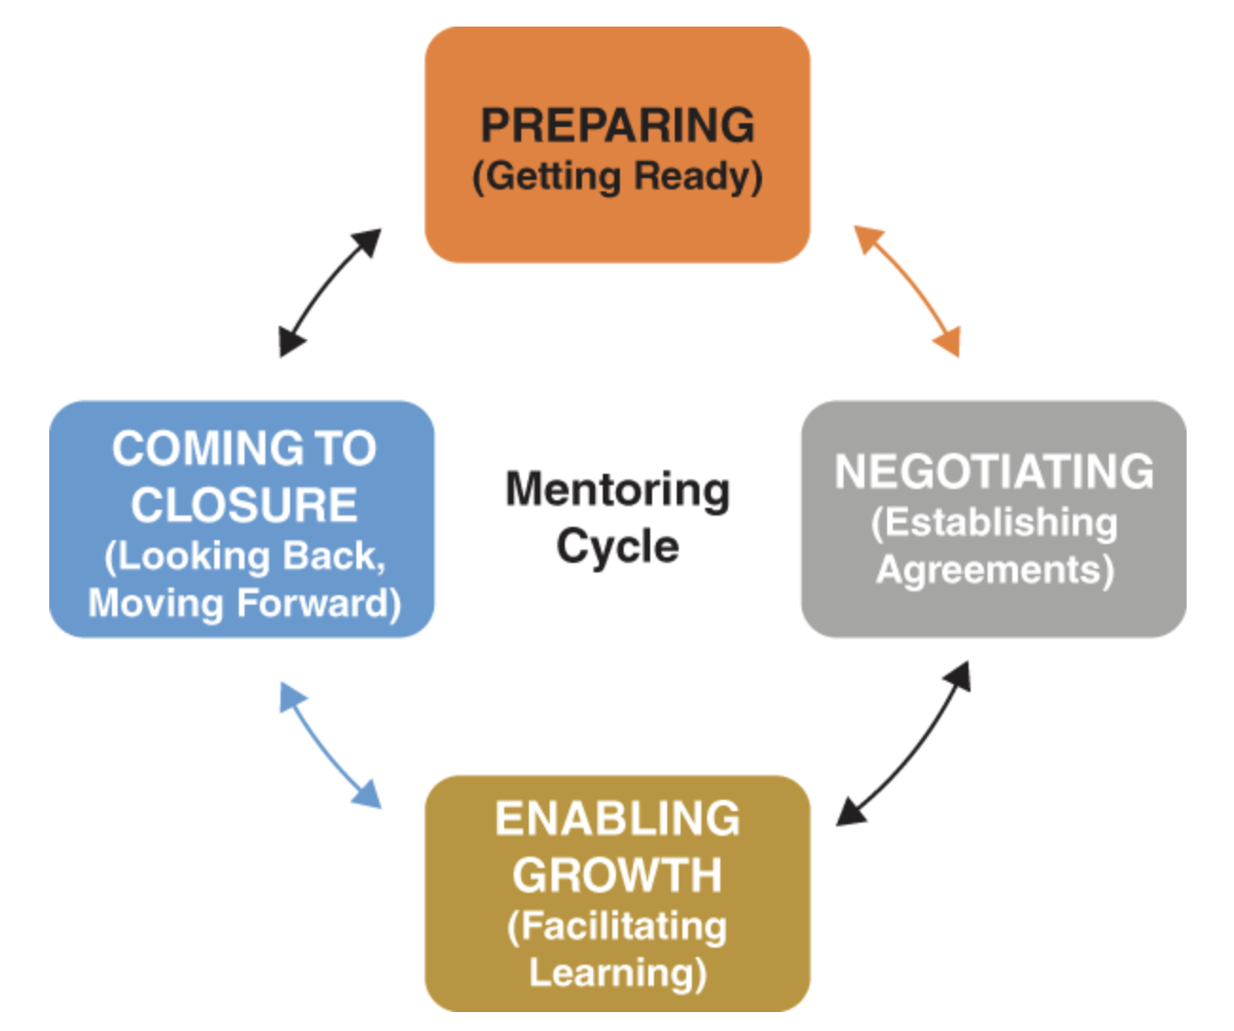
Mentor Self‐Reflection on Learning
Every relationship has its unique path. Use the following questions to help you reflect on your journey and think about its successes and challenges. The questions will assist you in identifying your next steps.
What are your mentoring gifts and strengths?
In what ways have you grown and developed as a mentor?
What have you learned about yourself?
Notes:
Every mentoring relationship is unique, shaped by experiences, challenges, and successes. Taking time to reflect on your journey as a mentor helps you recognize your growth, refine your skills, and plan for future development. To guide this reflection, consider these key questions:
What are your mentoring gifts and strengths?
In what ways have you grown and developed as a mentor?
What have you learned about yourself through this experience?
How has that learning contributed to your own professional development?
What areas do you need to improve to continue growing as a mentor?
How will you hold yourself accountable for this growth?
What action steps will you take, and when? By answering these questions, you gain deeper insight into your mentoring practice and set intentional goals for continued development. Mentorship is not just about guiding others—it is also a journey of self-improvement.Take a moment to reflect and identify the next steps in your growth as a mentor.

Slide 13
Mentor Self‐Reflection on Learning
How has that learning contributed to your own professional development?
What do you need to work on to further your development as a mentor?
How will you hold yourself accountable for your development?
What action steps will you take, and when?
Notes:
Every mentoring relationship is unique, shaped by experiences, challenges, and successes. Taking time to reflect on your journey as a mentor helps you recognize your growth, refine your skills, and plan for future development. To guide this reflection, consider these key questions:
What are your mentoring gifts and strengths?
In what ways have you grown and developed as a mentor?
What have you learned about yourself through this experience?
How has that learning contributed to your own professional development?
What areas do you need to improve to continue growing as a mentor?
How will you hold yourself accountable for this growth?
What action steps will you take, and when? By answering these questions, you gain deeper insight into your mentoring practice and set intentional goals for continued development. Mentorship is not just about guiding others—it is also a journey of self-improvement.Take a moment to reflect and identify the next steps in your growth as a mentor.

Slide 14
Turning Closure into Learning
Use the following prompts to reflect on what you have learned from your mentoring relationship:
What I have learned about myself
My mentoring gifts and strengths include
What I wish I could learn to do better
How I will apply what I have learned
Specific steps for applying what I have learned
Notes:
As we bring our mentoring relationships to a close, it’s important to reflect on what we’ve learned and how we can carry those lessons forward. This reflection helps us grow, not just as mentors and mentees, but as lifelong learners and leaders. To guide this reflection, consider these prompts:
What have I learned about myself through this experience?
What are my strengths and gifts as a mentor?
What areas do I still want to improve?
How will I apply what I’ve learned to future mentoring relationships or professional growth?
What specific steps can I take to put these lessons into action?
By taking time to reflect, we transform closure into a meaningful learning experience. The insights we gain will not only shape how we mentor in the future but also strengthen our leadership, communication, and ability to support others on their journey
Take a few moments to think about these questions and jot down your thoughts. Closure is not just an end, it’s an opportunity for new beginnings

Slide 15
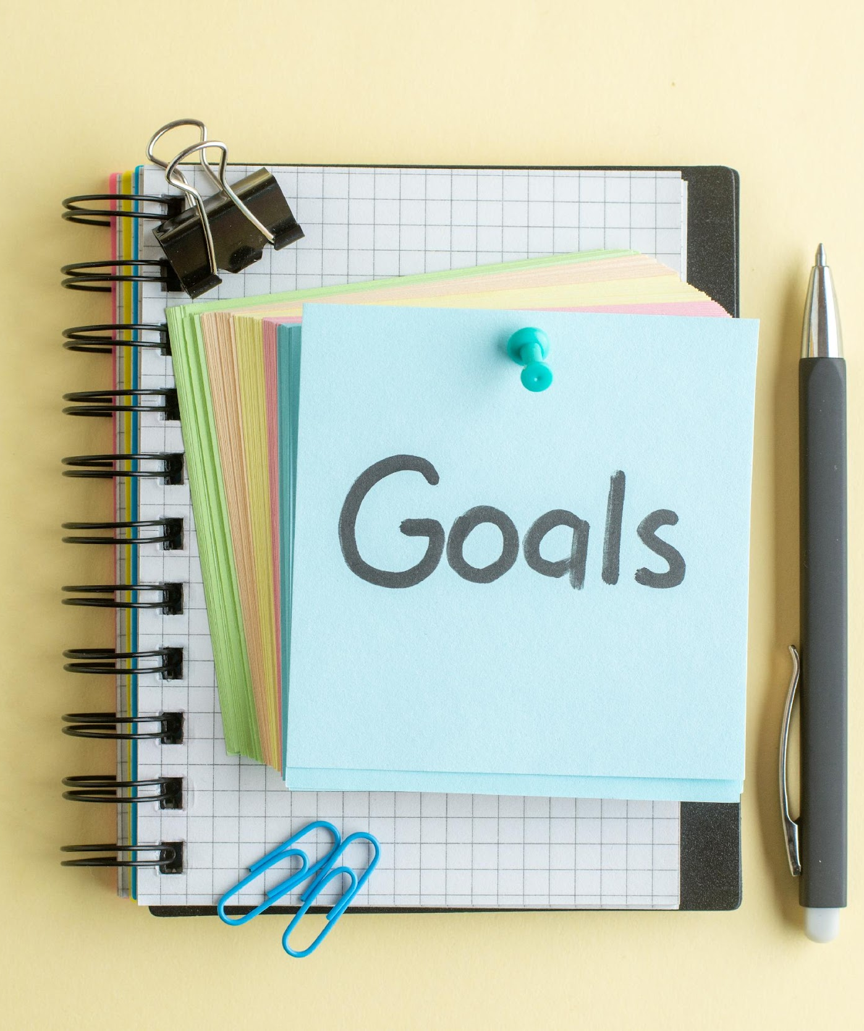
Check for understanding
Please share one way that you feel you have grown as a mentor.
What goals might you set for yourself the next time you are a mentor?
Notes:
Please share in the chat one way that you feel you have grown as a mentor.
What goals might you set for yourself the next time you are a mentor?
Pause to allow time for participants to respond.

Slide 16
Coming to Closure: A Readiness Checklist
Did we use the protocols we established to bring closure to the relationship?
Did we hold a meaningful learning conclusion conversation?
Did we adequately evaluate learning outcomes?
Did we discuss the application and integration of new learning?
Did we acknowledge our accomplishments?
Adapted from Zachary, L. J. (2012). The Mentor’s Guide. Jossey Bass.
Notes:
The preparation you do on your own in advance impacts your readiness to mentor and the quality of the mentoring relationship. Preparation of the relationship begins in earnest when the mentoring partners get to know one another and explore issues together. Getting to know a mentee does not mean knowing everything about that person. Rather, gaining a good sense about who the person is and what they bring to the relationship will help you make a strong connection and facilitate a more meaningful learning experience. Once the relationship preparation steps are complete, it is time to establish the agreements that build the foundation to support, guide, and nurture the relationship.
Are you ready to make a difference?
Are you ready to leave a beneficial contribution?
Are you ready to gain a sense of satisfaction from mentoring an apprentice?
Are you ready to put in the required energy, time, and passion into practice?
Discuss readiness checklist chart.

Slide 17
Coming to Closure: A Readiness Checklist
Did we celebrate milestones?
Did I identify the signals when it was time for closure?
Did I personally evaluate my own learning from this experience?
Have I identified ways to apply and integrate my new learning?
Have I decided what I would do differently as a mentor the next time?
Adapted from Zachary, L. J. (2012). The Mentor’s Guide. Jossey Bass.
Notes:
The preparation you do on your own in advance impacts your readiness to mentor and the quality of the mentoring relationship. Preparation of the relationship begins in earnest when the mentoring partners get to know one another and explore issues together. Getting to know a mentee does not mean knowing everything about that person. Rather, gaining a good sense about who the person is and what they bring to the relationship will help you make a strong connection and facilitate a more meaningful learning experience. Once the relationship preparation steps are complete, it is time to establish the agreements that build the foundation to support, guide, and nurture the relationship.
Are you ready to make a difference?
Are you ready to leave a beneficial contribution?
Are you ready to gain a sense of satisfaction from mentoring an apprentice?
Are you ready to put in the required energy, time, and passion into practice?
Discuss readiness checklist chart.

Slide 18

Wrap-up
Next session:_______________
Location/Link:________________
Questions?

Slide 19


Name, title, contact info

Slide 20
Resource Page
Zachary, L. J. (2012). The Mentor’s Guide. Jossey Bass.

