Slide 1

Community of Practice for Mentor Teachers
Session 2: Mentoring and Building Relationships

Slide 2

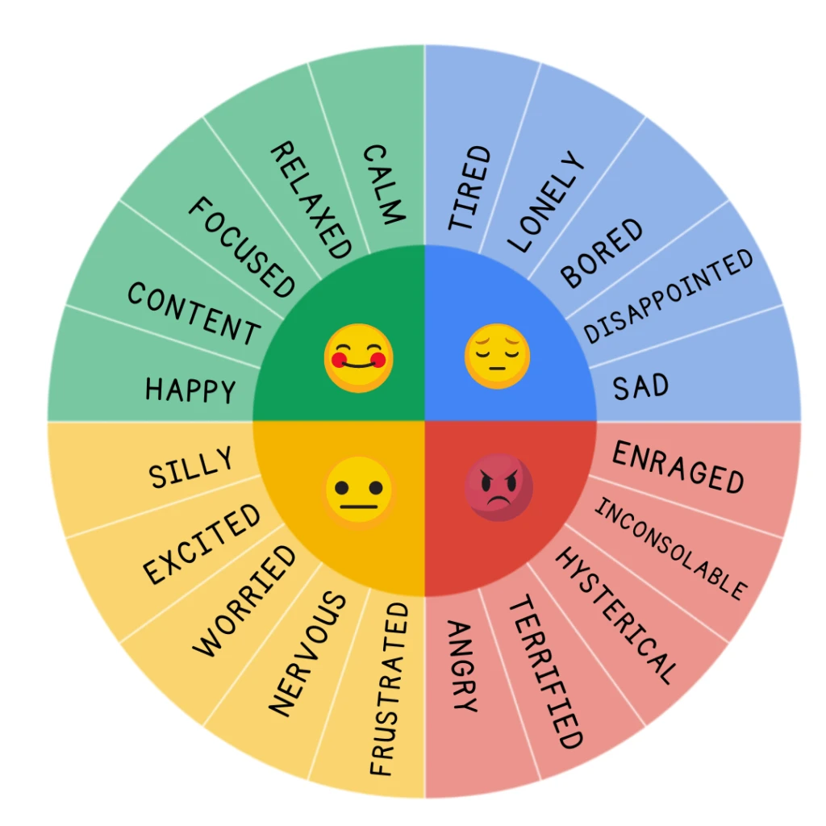
How are you feeling today?
Let us know how you’re feeling today.

Slide 3
How are you accessing this Community of practice?
If virtual, what technology are you using to engage with this webinar?
Type your answer in the chat (ex. a, b, c, or d)
Phone
Tablet
Laptop
Desktop

Slide 4
Where are you accessing this Community of practice?
If virtual, where are you accessing this Community of Practice?
Type your answer in the chat (ex. a, b, c, or d)
In a room with napping children
At home
In an office
Other

Slide 5

Agenda
What is a mentor?
Why is mentoring important?
Eight reasons to be a mentor
Session Wrap-up

Slide 6

What is a mentor?
A mentor is someone who gives advice to a mentee.
A mentor assists the mentee in developing as a professional.
A mentor provides guidance based on their experience and expertise.
Notes:
-Types of advice would be....
-Ways to assist might include....
-Guidance you might provide could be …..

Slide 7
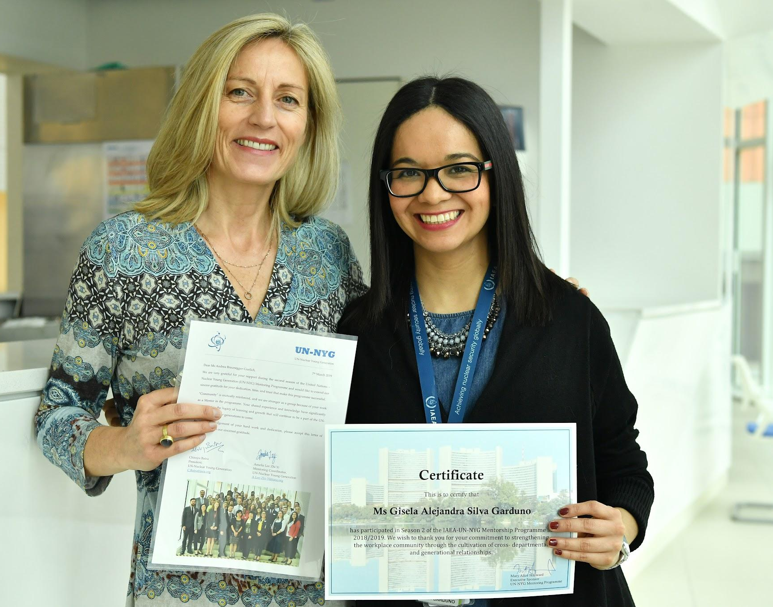
What is a mentor?
Take a few moments to reflect on a mentor in your life.
What were your mentor’s strengths?
What do you wish your mentor did differently?

Slide 8

Why is mentoring important?
A. Mentorship supports growth
B. Mentors serve as a source of knowledge
C. Mentors can help set goals
D. Mentors maintain accountability
E. Mentors offer encouragement
F. Mentors help make connections
G. Mentors are willing to listen
H. Mentors serve as a trusted ally
I. Mentors can offer constructive feedback

Slide 9
CHEck for understanding
1. What is one mentor quality in which you excel?
2. What is one mentor quality you need to improve?
A. Mentorship supports growth
B. Mentors serve as a source of knowledge
C. Mentors can help set goals
D. Mentors maintain accountability
E. Mentors offer encouragement
F. Mentors help make connections
G. Mentors are willing to listen
H. Mentors serve as a trusted ally
I. Mentors can offer constructed feedback

Slide 10
Check for understanding
Take a few moments to reflect on a mentor in your life and answer the following questions:
1. What mentor qualities were important for your development?
2. How did your mentor change your life?

Slide 11
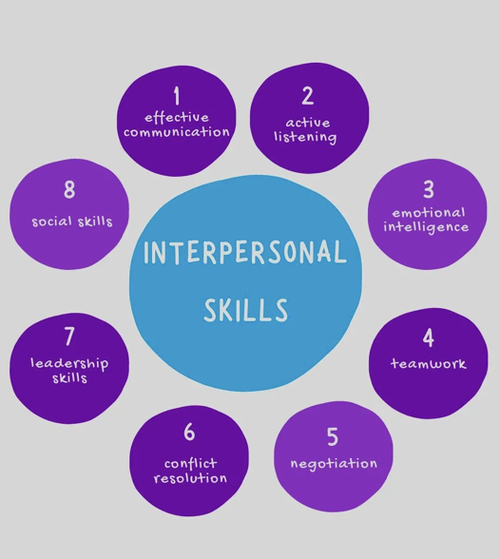
8 reasons to be a mentor
Improves interpersonal skills

Slide 12

8 reasons to be a mentor
2. Strengthens your knowledge

Slide 13
Check for understanding
What have you learned since becoming a mentor?

Slide 14

8 reasons to be a mentor
3. Allows you to shape the future of
the field

Slide 15

8 reasons to be a mentor
4. Expands your network

Slide 16
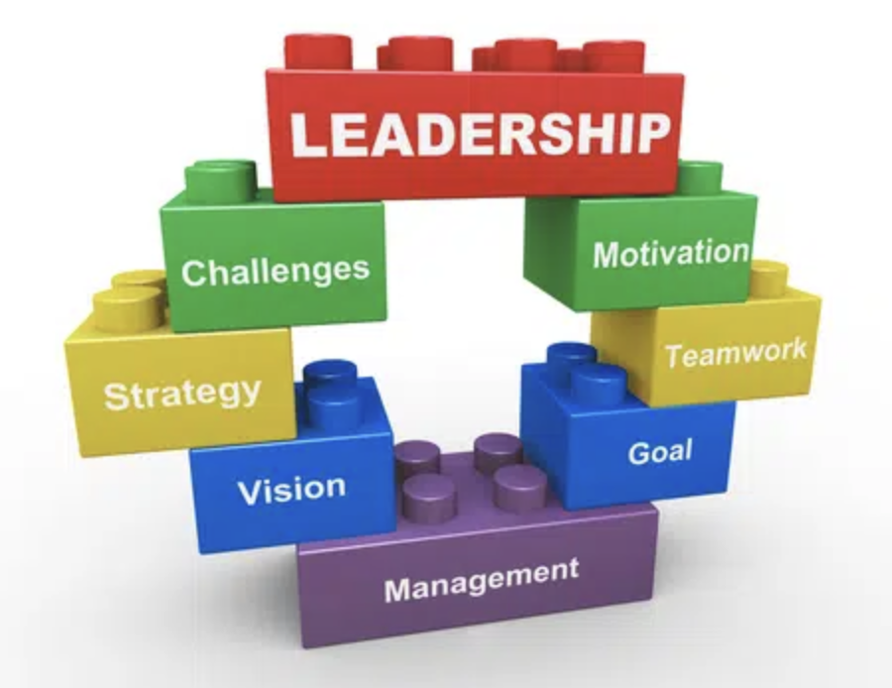
8 reasons to be a mentor
5. Establishes leadership skills

Slide 17
Check for understanding
What leadership skills do you hope to
gain from this experience?

Slide 18
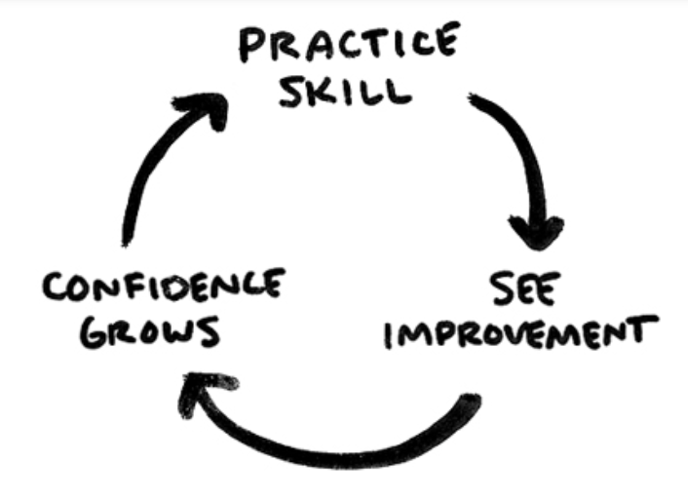
8 reasons to be a mentor
6. Builds confidence

Slide 19

8 reasons to be a mentor
7. Serves as a learning opportunity

Slide 20

8 reasons to be a mentor
8. Adds to your qualifications

Slide 21
Check for understanding
Why did you choose to be
a mentor?

Slide 22

Wrap-up
Next session:_______________
Location/Link:________________
Questions?

Slide 23
Resource from INdeed
https://ca.indeed.com/career-advice/career-development/why-is-mentoring-important#:~:text=Mentors%20maintain%20accountability%20An%20effective%20mentor%20holds,mentee%20doesn't%20lose%20focus%20of%20their%20objectives.

Slide 24


Name, title, contact info

