Slide 1

Community of Practice for Mentor Teachers
Session 8: Reviewing Lessons Learned; Ideas for Future Mentoring
Notes:
Welcome to session # 8, the last of our Community of Practice sessions! Today our focus is on reviewing lessons learned and developing ideas for future mentoring.

Slide 2

Agenda
Considering Lessons Learned
Ideas for Future Mentoring
Session wrap-up
Notes:
Our agenda for today is to share about lessons you have learned through the mentoring process, as well as considerations for future mentoring experiences. Finally, we will not only wrap up this session but recognize your completion of the mentoring experiences.

Slide 3

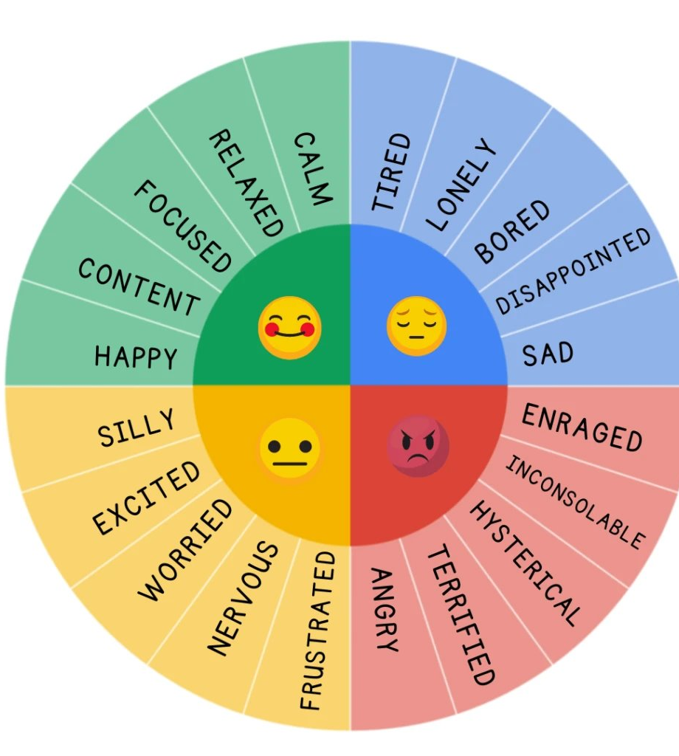
How are you feeling today?
Let us know how you are feeling about your apprentices' skill development over the last several months.
Notes:
Each month we've been asking how you feel. Today we'd like for you to identify in the chat how you are feeling about your apprentices' skills over the last several months. You may provide a sentence of explanation if you so desire.

Slide 4

Reflecting on the mentoring experience
You’ve been asking your apprentice to reflect on their learning.
Now it’s your turn for reflection!
Notes:
This slide introduces the first theme of this CoP, lessons learned from your mentoring experience.
Unlike your apprentice who has been reflecting on how they are meeting the competencies, as a mentor there’s no competencies identified for your role as a mentor.
Each month your apprentice is told to complete a self-assessment. In addition to reflecting on their improvement in each competency area, apprentices are expected to not only identify challenges and identify strategies for overcoming challenges but to also identify areas where they need more support. As a mentor, you may want to verbally state how you think your own lesson went in order to model reflection for your apprentice. Teachers often have developed skills in regularly evaluating their teaching on a lesson-by-lesson or daily basis; however, because it has become second nature for the teacher, it becomes easy to forget to demonstrate for the apprentice the reflection that you are regularly doing. When you verbalize your thinking for your apprentice you are granting them a glimpse into your thought processes and decision making.

Slide 5
Reflection: Part 1
Self-Reflection: What You Learned from Mentoring
1. What insights did you gain about yourself?
2. What did you do well as a mentor?
3. What could you have done better?
4. What commitment are you willing to make to raise the bar on your performance as a mentor?
5. How are you going to measure the success of your mentoring?
6. What did you learn that can carry over to other situations?
Adapted from Zachary, 2012, p. 224
Notes:
These questions can assist you in reflecting on your experience as a mentor. As they are each read aloud, consider for a moment how you might answer each one. (Session leaders will pause between each question to allow respondents to consider their response.)
What insights did you gain about yourself? (These could be almost anything from personal mannerisms to speech patterns, to recognizing feelings of discomfort at sharing difficult news with your apprentice, etc.)
What did you do well as a mentor? (What do you see as the successes of this experience?)
What could you have done better? (Where do you see room for personal growth as a mentor?)
What commitment are you willing to make to raise the bar on your performance as a mentor? (Would additional training assist you, and if so, would you commit to doing it? Are you willing to set aside more time for your apprentice in the future? Raising the bar does not mean that you did anything poorly the first time around, rather that there may be room for you to improve in specific areas.)
How are you going to measure the success of your mentoring? (Was simply surviving the experience reason to celebrate? Would you consider it a success if your apprentice did not meet all of the competencies?)
What did you learn that can carry over to other situations? (Are there things that you learned that you’ve been able to apply to other areas of your life?)

Slide 6

Check for Understanding
Thinking about the lessons learned in the previous slide, what are some things you have learned as you have mentored your apprentice?
Notes:
NOTE: While some participants may respond quickly to this question, it may take time for others to think of a respond. Be patient and allow time for the participants to consider their answers before sharing examples with the group.

Slide 7

Lessons Learned by other mentors
We all have more to offer than we truly realize.
Those we mentor can mentor us.
Quality of time is better than quantity.
Educate when you can. Don’t train.
Mentoring can and will change the world.
    iMentor.org, n.d.
Photo by Comstock Images on Freeimages.com
Notes:
Sometimes it is helpful to hear what others have learned about a topic or experience. Thees are a few lessons learned by Quinton, a mentor to a high school junior.
We all have more to offer than we truly realize. We don’t always recognize our knowledge, gifts and talents that can be shared as we mentor others. This is a reminder that we should never sell ourselves short. We DO have something to offer others.
Those we mentor can mentor us. The mentor / apprentice relationship allows learning to go both directions. Mentors may have learned new skills from their apprentices. Also, your apprentice is observing you, so be sure to practice what you preach.
Quality of time is better than quantity. Whether conducting a monthly or quarterly meeting with your apprentice or reviewing how a lesson went, remember that your words have weight. Be encouraging to your apprentice even when they may be having difficulty learning or implementing a competency.
Educate when you can. Don’t train. Training implies that you expect the apprentice to merely follow your guidance. Educating implies that you desire for the apprentice to engage in critical thinking.
Mentoring can and will change the world. When those with knowledge share it with an apprentice, the world will be better for it!

Slide 8

Another example
Mentorship is a two-way street.
Clear vision matters.
Networking
Adaptability is crucial
Manage your expectations
(Gietel, n.d.)
Notes:
Although similar to the ideas on the previous slide, this mentor notes a few differences. The photo of the coach and football player is a reminder that mentoring occurs in many different types of circumstances.
Mentorship is a two-way street. – A reminder that both the apprentice and mentor will learn from /through the experience.
Clear vision matters. – Having clear goals for the apprentice can guide the experience. Refer to the competencies early and often!
Networking – It’s one thing to share your professional network with your apprentice, but quite another to share with them how to build their own professional network.
Adaptability is crucial – Each mentoring experience will be different. Be cautious about making assumptions about your apprentice!
Manage your expectations – Develop clear boundaries and goals for your time together.
Mentorship is a two-way street
Mentoring isn’t just about imparting wisdom, it’s a collaborative relationship where both mentor and mentee grow. While the apprentice gains guidance and insight, the mentor benefits from fresh perspectives, renewed purpose, and sometimes learning new skills or trends from the mentee.
Clear vision matters
Establishing a shared vision from the start sets the relationship up in a meaningful way. What does success look like for the mentee? Use defined goals and ECE RAP competencies as guiding posts for your work together. Revisit these goals periodically to ensure the experience stays aligned and meaningful.
Networking
Helping your apprentice connect to your professional network is important. So is teaching them how to develop their own network. Show them how to seek out connections, follow up effectively, and maintain professional relationships. Model authentic networking and what it looks like to interact with your network.
Adaptability is crucial
No two mentoring relationships will look the same. Your mentee will have unique experiences, strengths, challenges, and needs. Stay curious and flexible. Be intentional about tailoring your approach to support this individual.
Manage your expectations
Boundaries and expectations should be set early to avoid miscommunication and burnout. Discuss things like how often you’ll meet, preferred communication methods, and feedback styles. Clear structure allows both parties to be fully present and engaged in the experience.

Slide 9
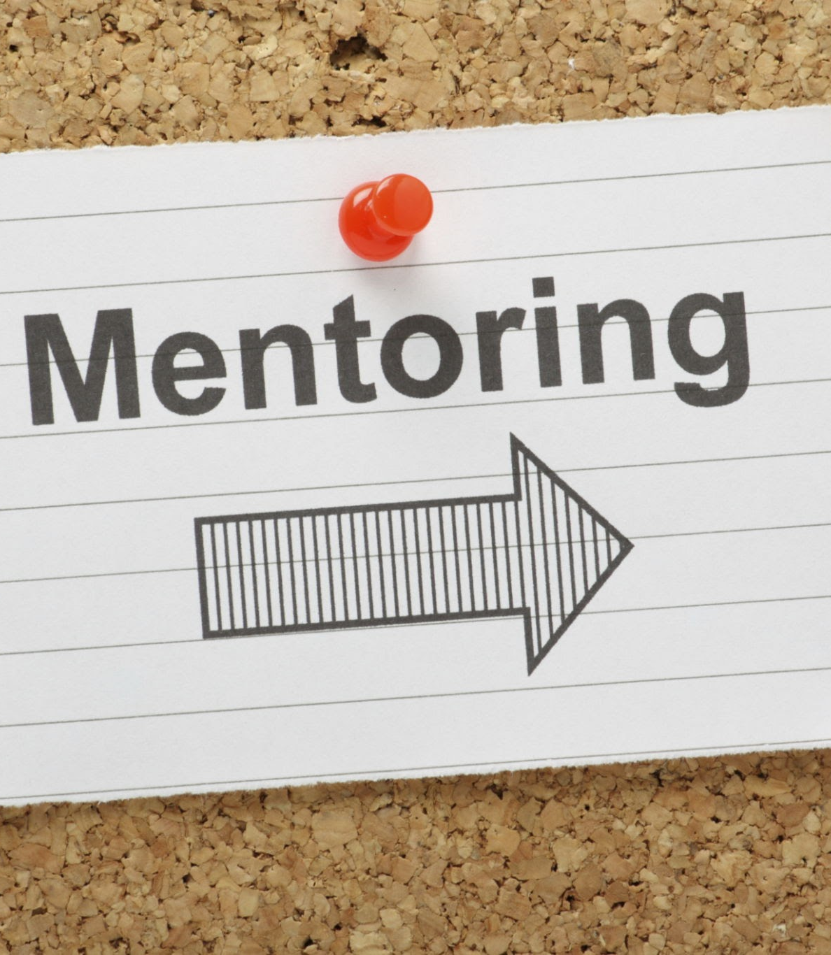
Check for Understanding
Lessons Learned from Previous Slide:
We all have more to offer than we truly realize.
Those we mentor can mentor us.
Quality of time is better than quantity.
Educate when you can. Don’t train.
Mentoring can and will change the world.
Notes:
NOTE: While some participants may respond quickly to this question, it may take time for others to think of a respond. Be patient and allow time for the participants to consider their answers before sharing examples with the group.

Slide 10

Using Reflection for Future Mentoring
Notes:
We will now transition to how you can use reflection to plan for future mentoring.

Slide 11

Preparing to be a mentor again …
Consider what you would like to change as a mentor.
Identify areas for improvement.
Enhance your understanding of apprentices.
Promote continuous learning.
Facilitate a reflective environment for your apprentice.
Notes:
During CoP session 7 we asked you to consider what went well in your mentoring and where you saw areas for improvement. Completing your first mentoring experience may cause you to want to be a mentor again and this in this slide we’ll talk about how you can take your first mentoring experience to improve your skills for the next time.
First, you’ll want to identify areas for improvement. This doesn’t necessarily mean you did anything wrong, rather this is an opportunity to continue to strengthen your mentoring skills. To do this, you will want to…
recognize trends and issues. Reflecting on this first mentoring experience can allow you to see patterns and biases that can influence your interactions with your apprentice. For example, what were your expectations of your apprentice’s abilities at the beginning of the experience? Did you assume that they would do well or struggle during the experience? Why do you think you made those assumptions?
refine your approach. By examining your strengths and weaknesses you can begin to identify how to tailor your mentoring approach to better meet the needs of your apprentice. For example, do you have a better understanding now about the competencies and how you might assist your apprentice in developing those skills?
enhance effectiveness. Were there strategies that you used to guide your apprentice to learn or implement a competency? Remember that you may need to adjust those strategies with a new apprentice.
Second, you will likely continue to enhance you understanding of apprentices. You can do this by …
acknowledging your apprentice’s progress. Each apprentice may receive encouragement differently. Thus, you while your first apprentice was happy with verbal encouragement about their progress, your next apprentice may want to see written encouragement about their progress.
providing targeted feedback. Understanding that each apprentice’s journey is different can allow you to personalize the feedback that you provide.
fostering stronger relationships. Acknowledging your apprentice’s accomplishments can deepen the connection and relationship with your apprentice.
Third, as you serve as a mentor you will want to promote continuous learning within yourself. This can include …
remaining current with best practices. Select professional development opportunities that will allow you to keep up-to-date with the latest research in early childhood education and techniques in mentoring.
developing new skills. By reflecting on your first mentoring experience, you might discover areas where you need to develop stronger skills in order to better meet the needs of your apprentice.
expanding your mentoring horizons. As you learn more about mentoring you can become a more effective mentor.
Finally, through your own self-reflection you will be able to facility a reflective environment for your apprentice. This can be done as you …
model reflective thinking. As you demonstrate self-reflection you will encourage your apprentice to engage in critical thinking and self-assessment.
provide a safe space for exploration. Your apprentice will need a supportive environment where they can reflect on their experiences and challenges in order to grow.
help your apprentice identify learning opportunities. You next apprentice may need opportunities for additional growth outside of their experience in your classroom. Be knowledgeable regarding additional resources for learning and professional development.

Slide 12

Check for understanding
As you consider serving as a mentor to another apprentice, what is one way you want to improve your mentoring skills?
Notes:
Pause in order to allow participants to reflect on what they have just heard and to select a way they want to improve their mentoring skills. You may want to provide an example of something you did to improve your skills in mentoring or teaching. When answers being appearing in the chat, you might select one or more to read aloud to the group.

Slide 13
Wrapping up the Community of Practice
Notes:
This is our last Community of Practice session and we want to take a few moments to bring this to a close.

Slide 14

This is not the end of the road …
We have experienced these Community of Practice sessions with you for the past 7 months, and although we will no longer be meeting regularly, this is just a part of your journey as a mentor working with an apprentice.
It is our hope that you have felt supported as you have journeyed through your mentoring experience.

Slide 15

What are the ways that we could improve?
We are also looking for ways to improve how we conduct our work, so we would like to allow some time for you to evaluate us.
What is something we did well?
What is something that you would like to see us improve?

Slide 16
Final thoughts:
THANK YOU for the time you have spent participating in the Community of Practice sessions!

Slide 17

Name, title, contact info

Slide 18
Resource Page
Geitel, N. (Nov. 27, 2024) Ten lessons learned from a decade of mentoring. Downloaded Apr. 10, 2025. https://www.thecareerlounge.co/blog/lessons-from-mentoring
iMentor. Mentor Wisdom: The seven things I learned since becoming a mentor. Downloaded Apr. 10, 2025. https://learn.imentor.org/help/mentor-wisdom-the-seven-things-i-learned-since-becoming-a-mentor
Zachary, L. J. (2012) The mentor’s guide: Facilitating effective learning relationships (2nd ed.). Wiley.

